Slide 1
JK Agent Sales Training Call
Thursday, December 15, 2022, 1PM CST
Zoom Meeting Link: https://zoom.us/j/3738421209

Slide 2
Compass Health Consultants Upcoming Events
TODAY IS THE LAST DAY FOR ACA JANUARY 1ST START DATE
Friday, December 16 Live Role Play with Ghaleb Zayed
Friday, December 16 CHC Care – Healthcare Advocacy Training
Tuesday, December 20 TopBroker Training
Friday, December 23 Tanya Mosley’s 21st Birthday
Compass Health Consultants Agency Meeting Friday, February 24, 2023!

Slide 3
Agents currently have access to Humana group Dental Vision and life If they have 100 per month in Compass revenue. Starting Jan1st, we will have Access to IHP Group health. (As long as we have 5 participants) Compass will Contribute $100 per month.

Slide 4
Update
Partners,
We are writing this letter to inform you that the rates on the IHP Plans will be increasing for Limited Partners of Outreach Data Partners that are enrolled in the IHP Plans for 2023. The rates will be changing on your January deduction to cover your plan starting in February.
The increase will take place to and the amount of the increase will vary depending on which plan that someone is enrolled in. The new rates that our clients will see will match the current rates we are offering the plan to our new customers. This is necessary for compliance, as this is a group plan, so all of our clients must be paying the same rate. The average increase is between 5% and 10%.
This rate increase is due to increased claims within the plans, so please be sure that we are being good stewards to the plan as we enroll clients going forward. Please let me know if you have any questions.
Joseph Krivelow
Founder

Slide 5
Elevate Wellness Update Subject: Member’s 2023 Renewal letters now viewable online
Great news! In addition to the members getting their renewal letters by mail; both you and your member can view the renewal letter online in the Member Dashboard and Rep Dashboard.
Instructions for the MEMBER Dashboard:
1. Log into the Member Dashboard: https://dashboard.purenroll.com/
2. On your home page click the link in the top right corner. The text will read: “New Rates as of January 1, 2023 – Click here to view”
Instructions for the REP Dashboard:
1. Log into the Rep Dashboard
2. Click on Manage
3. Click on View Members
4. Search for the member
5. Click on the paper icon “View Cards”
6. Scroll to the bottom of the popup window
7. Click on the link to view the New Rates as of January 1, 2023
The Elevate Wellness Team

Slide 6
CHC Care Healthcare Advocacy Update
Subject: New Contracting
Email request to Tanya Mosley. Agents will receive a Marketing Agreement to complete and return to Tanya. Once the information is submitted agents will receive a link to activate their personal link.
Don’t forget there is training tomorrow!

Slide 7
ACA Update

Slide 8
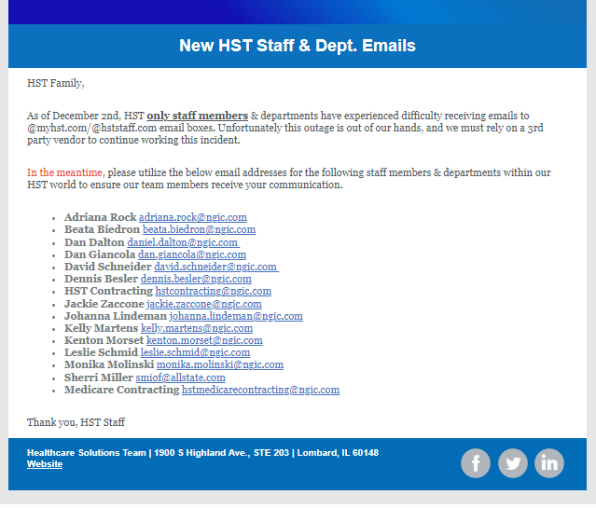
EMAILS, EMAILS, EMAILS
Our agency email communication has been down for about a week.
Please use our Agency calendar at www.chcagents.com, or our Team Chat to stay up to date on our events, trainings, and meetings.
We look to have this situation corrected soon.

Slide 9
IHP Contest Update
Agent | Total Sales | Bonus
Thomas Trifaro | 58 | $8,700
Phillip Vogt | 42 | $6,300
Zac Masters | 28 | $4,200
Anthony Carpenter | 10 | $500
Kent Stansfield | 9 | $450
Tim McCormick | 8 | $400
Paul Rosenthal | 7 | $350
Yvonne Valdez | 7 | $350
Janet Rhonehouse | 6 | $0
Sherry Parker | 6 | $0
Amanda Miller | 5 | $0
Jessica Skoney | 5 | $0
Brian Drennon | 4 | $0
Chuck Fuller | 4 | $0
Corey Harper | 4 | $0
Richard Hyde | 4 | $0
Robert Hyde | 4 | $0

Slide 10
CHC Celebrating Success
Top 10 Agents This Month
1ST APP SOLD
Rank Name #Apps
1 Jennifer Earp 103
2 Tim McCormick 88
3 Suzanne O'Connor 71
4 Lairah Seymour 66
5 Kathryn Canlas 65
6 Sean Thacker 63
7 Mary Dynes 61
8 Jamie Baumeister 54
9 Daniel Levine 54
10 Phillip Vogt 52
Agent | Manager
Michael Hallinan | Emmanuel Hotya
Noelia Zamora | Sue Weick
Michael Kalin | Philip Vogt
Walid Edwards | Kent Stansfield
Matthew Martin | Philip Vogt
Jennie White | Kim Kirsch
Brian Robinson | Philip Vogt
Nivram Acoff | Jeffrey Seymour
Rebecca Harding | Matthew Fisk
Ulrich Sterling | Brian Drennon

Slide 11
5 YEAR HST ANNIVERSARY
Herbert Hall
Amber Wise
Brian Rose
Frederick Kirsch
Una Walters

Slide 12
We wish you the best holidays with your friends and family and looking forward to
our success in 2023! Thank you for you all you do to make Compass Health Consultants
the best in the business. -Joe Krivelow & The CHC Staff!

