Slide 1
JK Agent Sales Training Call
Thursday, July 13, 2023
1 PM CST
Zoom Meeting Link: https://zoom.us/j/3738421209

Slide 2
WELCOME TO OUR NEW AGENTS
Sell your first application by next Friday, July 21st and receive a Compass Shirt and $100 Lead Credits!
Happy Selling!
Do you know someone looking for a new career?
Our next CHC New Agent Training & Development is July 25th & 26th in St. Louis, MO. Send your referrals to Liz Wardrop, ewardrop@chcquotes.com, and you could get free lead credits.

Slide 3
Upcoming Training & Events
If you are having difficulties joining a meeting, please email Tanya Mosley, immediately for assistance. If you join a training session late, please note trainers will end the meeting for lack of participation and access will not be available.
7/14/2023 9:30 AM CST : CHC Training: America's Choice
7/15/2023 11:00 AM CST : Super Saturday Agent Training
7/18/2023 1:00 PM CST : TopBroker CRM Training
7/20/2023 1:00 PM CST : CHC Training - Life Insurance
7/20/2023 3:00 PM CST : CHC Training - NCD Dental
7/21/2023 9:00 AM CST : CHC Mastermind 2023
8/11/2023 9:30 AM EST : CHC Tampa FL Agency Celebration
JULY MONDAY MADNESS
7/17 ~ Pivot
7/24 ~ Ameribenefit – Tristar
7/31 ~ Walk & Talk Like a Pro
JULY KickStart to Superstart
7/18 ~ First 5 Seconds & Elevator Speech
7/19 ~ Show Me The Money
7/20 ~ Expectations & Action Plans
7/25 ~ Handling Objections
7/26 ~ How To Build Your Business
7/27 ~ Attitude Is Everything

Slide 4
MASTERMIND
Welcoming suggestions and topics from the entire agency!
Please send your ideas, thoughts, and suggestions for the improvement and growth of Compass Health Consultants to Tanya Mosley, tmosley@chcquotes.com.

Slide 5
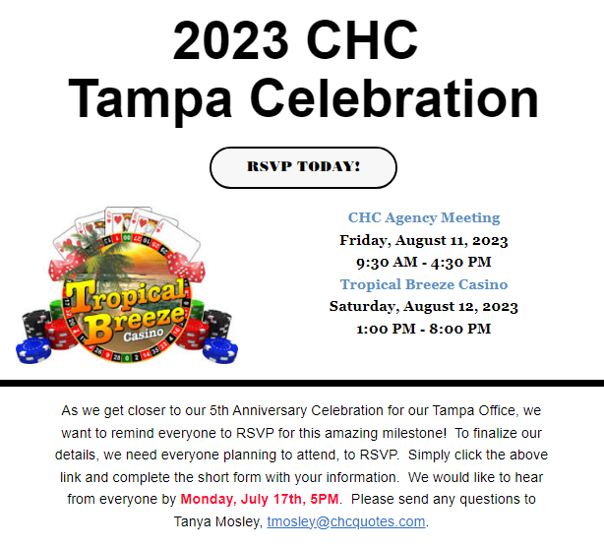
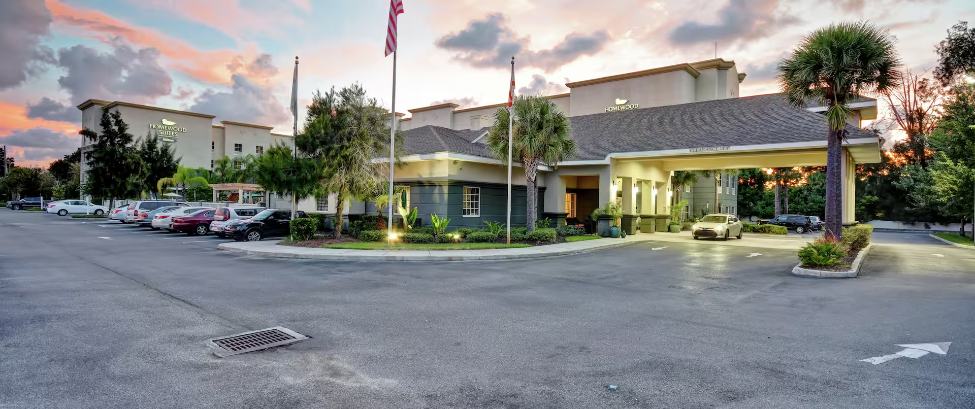
Homewood Suites by Hilton Tampa-Port Richey
11115 US Highway 19 North
Port Richey, Florida, 34668, USA
727-819-1000
Please follow the below instructions to book your reservations online. Or call the hotel and tell the front desk the dates and that it is for the “CHC Tampa 5 Year Anniversary”.
· Please tell you guests to click this link - Homewood Suites Tampa-Port Richey Extended Stay Hotel (hilton.com)
· Then click the “Special Rates” button
· Type “CHC” in the Group Code area. Then click the X at the top
· Click the “Check Room & Rate” button
Event RSVP https://forms.office.com/r/tACDpnpJu6
Thank You to everyone that has RSVP’d!

Slide 6
Consumer Alert: Licensing Renewal Email Scam
Nevada Division of Insurance (06/26/23)
The Nevada Division of Insurance has been made aware of an email phishing scam targeting licensed insurance producers and agents in Nevada. The division has received several phone calls from licensed individuals reporting that they have received a fraudulent email claiming that their license may be revoked if they do not pay an amendment fee via a payment link embedded in the email. The email is being sent from INSURANCE LICENSING with the subject line: Nevada Division of Insurance AMENDMENT FEE. This email is not from the Nevada Division of Insurance. Please do not click on any links and delete the email immediately. All official Division of Insurance Licensing emails are sent from nevada.licensing@doi.nv.gov or renewal.desk@doi.nv.gov. Emails received from any other addresses claiming to be the Division of Insurance should be considered fraudulent and should be deleted.
Read Story

Slide 7
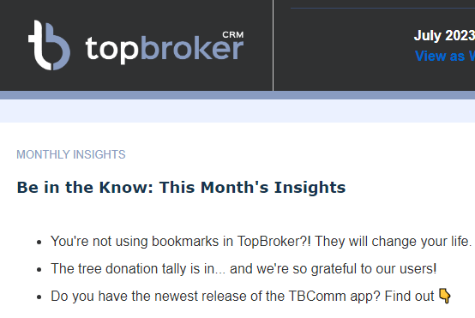
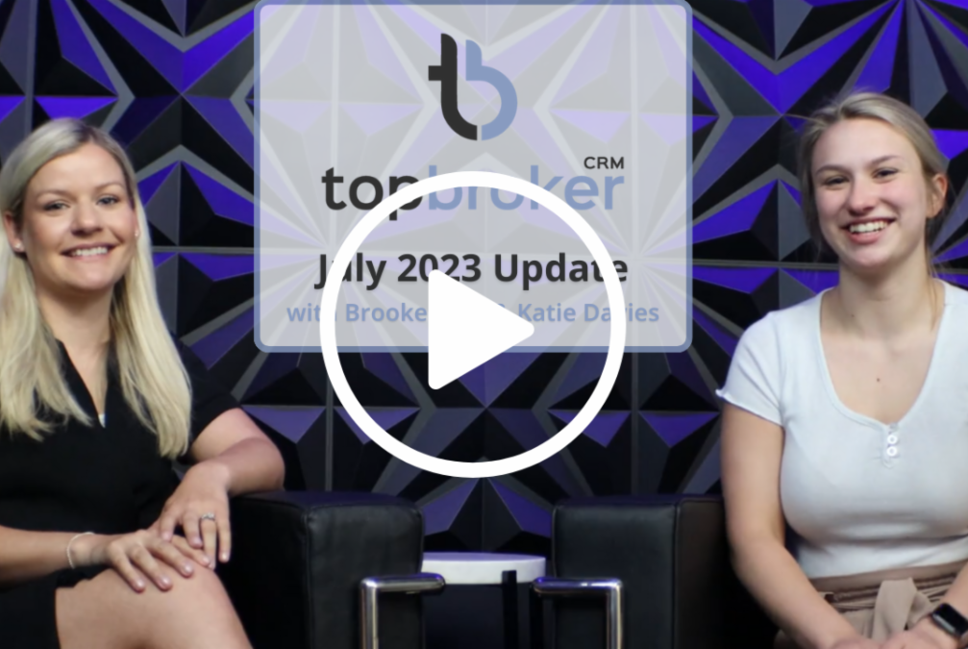
TopBroker Updates

Slide 8
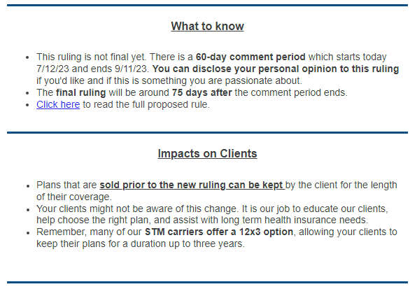
New proposed rules would limit short-term health insurance to no more than four months

Slide 9
Medicare Open Enrollment Dates Oct 15–Dec 7 ARE YOU READY?

Slide 10
HST Medicare,
We are happy to announce that AHIP 2024 is LIVE today! You may use the link below to access the exam with an embedded discount. The link should ask you to pay $125. No discount code is needed. Let's get AHIP and Carrier certifications completed as soon as possible! www.jsamedicareahip.com
AHIP Reimbursement Program:
Must have 2 Medicare MAPD contracts through HST (ex. UHC, Humana)
Must email a copy of your completed certificate to training@myhst.com, along with letting them know what 2 MAPD contracts you hold with us
Reimbursement is ONE time only, your first time taking the exam with HST
Training Assistance:
If you take the exam one time and do not pass, please reach out to training@myhst.com for assistance.
If you have additional questions, please reach out to a team member below.
Sherri Miller, smiof@allstate.com
Monika Molinski, monika.molinski@ngic.com

Slide 11
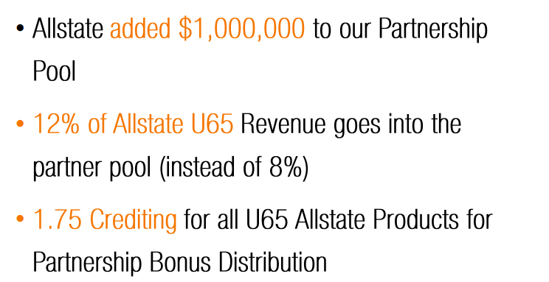
Allstate is launching HSA compatible plans
Current Set for July 27th release
Training & more information to come
Allstate – HSA STM Plans
COMING SOON

Slide 13
IHP CANCELLATIONS June 2023 – Present
Increased cancellations in the past 6 weeks since the carrier inception
Is there an issue?
Reporting available for agent follow-up

Slide 14
CHC Life Department
https://www.chcagents.com/quility-contracting
https://www.chcagents.com/hero-life-contracting
https://www.chcagents.com/plumlifecontracting
Life Platform and Contracting Recorded Link
https://us02web.zoom.us/rec/share/-m3aVhV-YQacIxoUNQ_u_Dalv8egipNl4oMlwVRpr86hXodTzxeHfUH4v4Y_CL7m.6rr9eB2qBplJKjIp

Slide 15
CHC Exclusive Carrier – America’s Choice
Compass Health Consultants
Exclusive Carrier Training
America's Choice
Friday, July 14, 2023
9:30 AM CST
Zoom Meeting Link: https://zoom.us/j/3738421209
Contracting Link Below
Medalist Formulary Link
https://www.medalistrx.com/members
Chronic Formulary
https://forms.office.com/r/rJWg2hM4gE
America’s Choice Commissions
Will pay on the 21st this month
Future Payment Dates will be the 14th of the month

Slide 16
Top 10 Agents This Month
Rank Name #Apps
1 Jordan Krugman 27
2 Jennifer Earp 20
3 Jamie Baumeister 18
4 Tim McCormick 16
5 Denise Sullivan 16
6 Loye Diane Kimbro 16
7 Phillip Vogt 15
8 Richard Hyde 14
9 Sean Thacker 14
10 Trevor Magloire 12
Top 10 Agents June 2023
Rank Name #Apps
1 Michael McAllister 57
2 Richard Hyde 52
3 Jeffrey Seymour 52
4 Phillip Vogt 49
5 Tim McCormick 47
6 Anthony Carpenter 42
7 Jamie Baumeister 41
8 Jordan Krugman 39
9 Jennifer Earp 37
10 Lairah Seymour 35

Slide 17
1ST APPLICATION RECOGNITION
Agent | Mentor
David Gagleard | Philip Vogt
Thomas Davenport | Kim Kirsch
Amy Handel | Sue Weick
CONGRATULATIONS AGENTS!

Slide 18
CONGRATULATIONS
Suzanne O’Connor
Available on Amazon tomorrow, July 12th for a special friend and family price of $5.99! I hope to hear how this message helps you through your life as much as it helped me. The link below should be live tomorrow, and will direct you to the Amazon page to buy the book; if not I will post the Amazon link on my page tomorrow :) https://www.yourdailyrenewal.com/
At this time, the link is not active. As soon as it is we will resend to the agency.

