Slide 1




JK Agent Sales Training Call
Thursday, March 16, 2022
1:00 PM CST
Zoom Meeting Link:
https://zoom.us/j/3738421209

Slide 2

CHC Upcoming Trainings & Events
Ongoing Training
Upcoming Sales Training
KickStart to Superstart (T, W, TH)
Team Dials w/Q&A (T, W, TH)
TopBroker Training (Every Tuesday)
CHC Care Training (1st & 3rd Friday each Month)
March 20th Monday Madness – MEC Plans
March 23rd Compass Sales Training – CHC Group Department Training
March 27th Monday Madness – Keeping Clients Happy
March 30th JK Agent Sales Training Call

Slide 3

CHC Exclusive Carrier Training
IHP Training w/ Q&A
Thursday, March 23rd
5PM CST
https://zoom.us/j/3738421209

Slide 4

Special Training Event w/ Phil Vogt
Making the Sale
Sunday at 12 EST
Join Zoom Meeting
https://us06web.zoom.us/j/8381306731?pwd=bTlsTWpGR0JYdFlLd0V2aFZnK2g5dz09
Meeting ID: 838 130 6731
Passcode: VIP

Slide 5
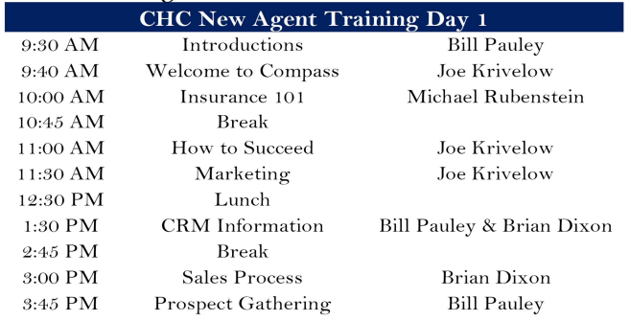
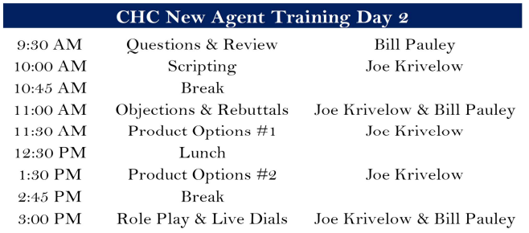

CHC LIVE New Agent Training Tampa, FL
April 11th & 12th

Slide 6
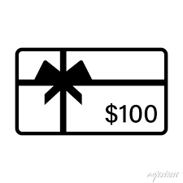

CHC NEW AGENT INCENTIVE
All agents that get their first app by Friday Get $100 in lead credits and a compass shirt

Slide 7

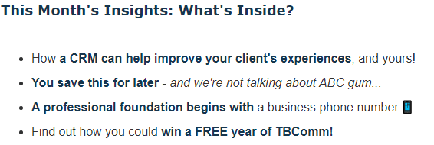
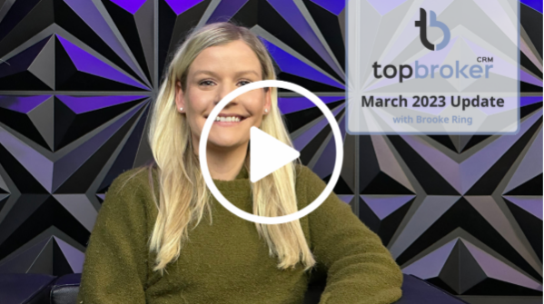

TopBroker Training
Every Tuesday, 1:00PM CST

Slide 8

CHC Lead Updates
Group Leads $60
Exclusive Leads $19
ACA Exclusive Leads $9

Slide 9
HST'S EMAIL SWITCHOVER
The tentative date that this is going to happen is 3/31/23.
Why are we doing this?
Increase security of your emails
Add in Spam blocking features
Faster emails both sending and receiving!
Less chance of your emails being blocked as Spam
How Does This Affect You?
You will not have access to your @myhst Email from 3/30/23 to 4/3/23
Any emails that are received during those dates will be lost
Before 3/30/23 please go into your HST email and delete any emails you no longer need (it will help the transfer happen faster)
Your new email login information will be located in LeadMaster when you log in on 4/3/23.
EXAMPLE AUTO RESPONSE: Attn: Clients and Business partners - We are upgrading our email server to provide a better and more secure experience.
Due to this, I will have NO EMAIL ACCESS from Mar 30 thru April 3. Please make a note to use my alternate email address during this time - jskrug26@yahoo.com. Or of course you can shoot me a text @ 314-602-4055. Thank you so much.
Questions?
If you have further questions on the new email system and how it will affect you, please feel free to email Adam Brewer at adam.brewer@ngic.com.

Slide 10

Why www.chcagents.com
Everything Compass
Most Current Forms. (Please use the most recent versions for forms and documents from our site as they update frequently. Specifically New Agent Paperwork)
You don’t have to wait for Tanya to give you contracting links! They are all included on the site.
Most recent Training Videos are added to the site within 48 hours of ending.

Slide 11


Dear Agents,
Earlier this year S&S released a new portal for all clients. The software used for the portal is called, "MedXoom."
Clients can access their ID, check on their active claims, search doctors in network near them and access basic plan information on all their "MedXoom" portal.
The account creation can be done AFTER the client's effective date. This is because they have not loaded into S&S's system until then. It can take 2 - 3 days for all the clients to load into the system. Wait until the 2nd or 3rd to try to create their account.
If your CLIENT'S PAYMENT WAS LATE this will delay them loading into S&S's system until the 2nd or 3rd week after their effective date. They will still have coverage and be active on the 1st, however; they just will not be able to access their ID and will have to fill out a claim form if they attempt to use their coverage during that time.
We recommend that agents create the account for the clients, hopefully to prevent any technical errors that could arise.
If you have any questions or issues that specifically relate to "MedXoom," please feel free to email Dakota at agentsupport@chcquotes.com.

Slide 12
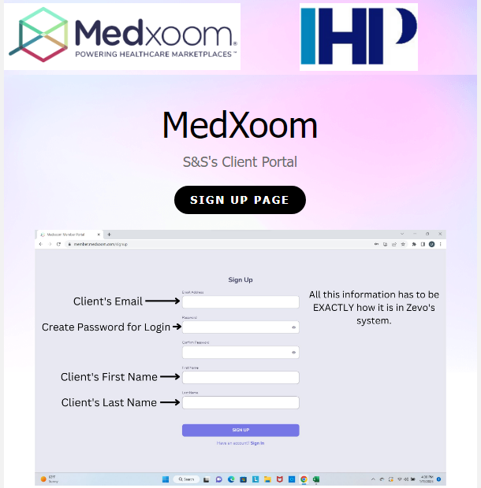
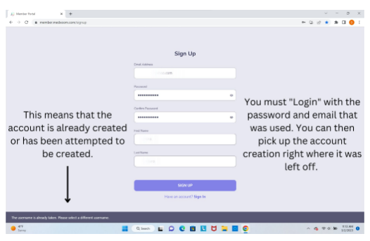
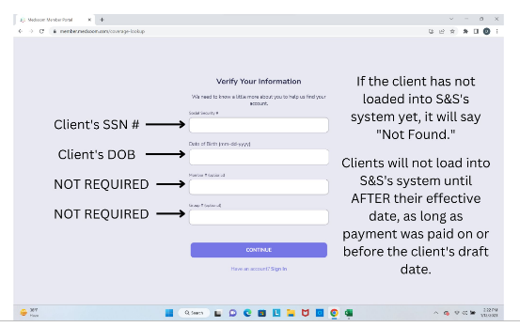

Slide 13
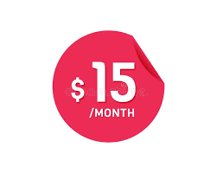
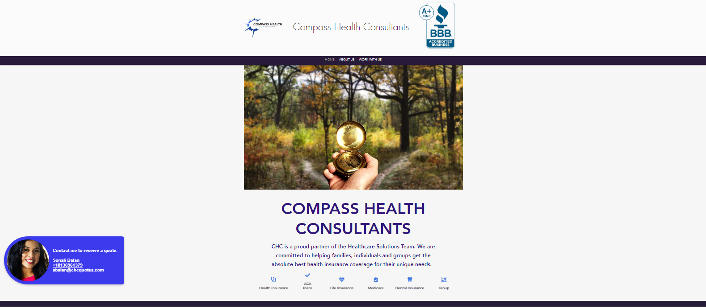
CHC AFFILIATE SITE

Slide 14

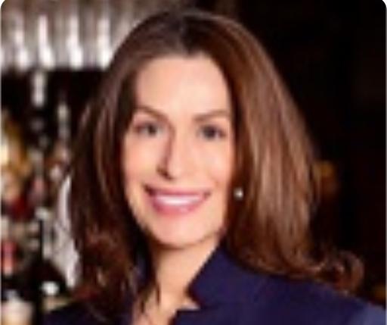
Traveling nurse in MI. Blue state, doesn't like STM-has to be renewed every 6mo by different carriers. Client was up for renewal, quoted Allstate and her plan doubled in monthly premium. I thought about her options and gave her a quote for ML fixed benefit affordable choice plan, with ML out-of-pocket protector, and Allstate hospital fixed benefit plan F. The final piece was her CHC care plan - she was immediately onboard with the value there.
So, one app client to 4 app client. Saved her the headache of renewing every 6 months...Hell Yeah! Heather Health insurance...it's where all the cool people get health insurance.
Do you have a success story you would like to share? Email your stories to Tanya Mosley, tmosley@chcquotes.com.

Slide 15



CONGRATULATIONS
Brian Robinson
SUPERSTART REACHED

Slide 16

CONGRATULATIONS
Agent | Manager
Jonathan Wallace | Emmanuel Hotya
Francoise Cain | Joe Krivelow
Andrea Goldstein | Kent Stansfield
Nathan Estes | Karly Vogt
Sally Hensley | Janet Rhonehouse
Sylena Rodriguez | Tia Young
Brandon Pitti | Anthony Carpenter
Kenneth Wright | Anthony Carpenter
Darius Mills | Phillip Vogt
1ST SALE

Slide 17

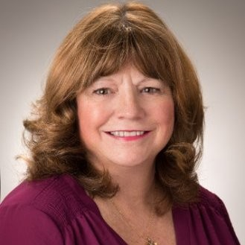
HAPPY BIRTHDAY PEGGY!
We Love You!

Slide 18

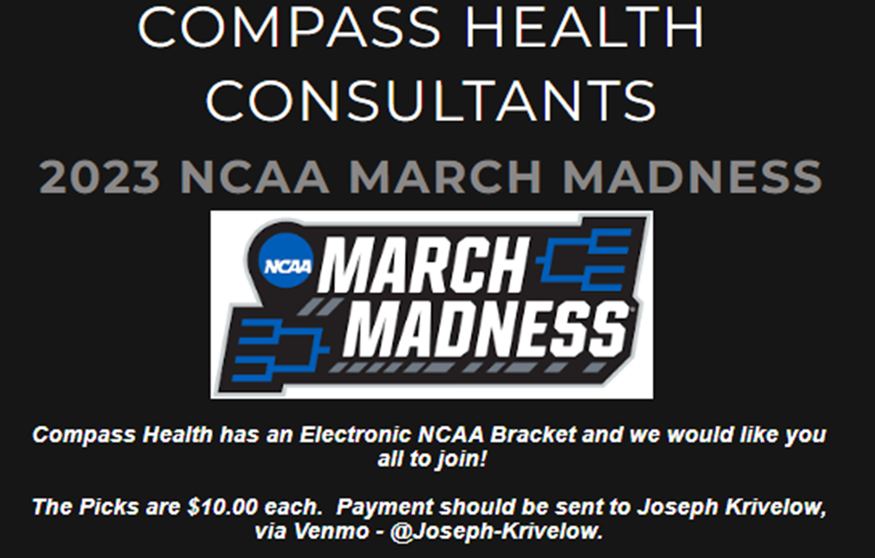

Slide 19


Do you have a satisfied customer review on
social media? Share it with us!
@COMPASSHEALTHCONSULTANTS
Did you know, agents receive a bonus for
referring a recruit to HST/CHC?
GLASSDOOR REVIEWS
https://www.glassdoor.com/
Share your CHC photos with Sonali Balan, sbalan@chcquotes.com & Tanya Mosley, tmosley@chcquotes.com
We are hiring 2 people - Interview specialist & Special Project Coordinator
(STL Office Positions)

