Slide 1


JK Agent Sales Training Call
Thursday, June 15, 2023
1 PM CST
Zoom Meeting Link: https://zoom.us/j/3738421209

Slide 2

WELCOME TO OUR NEW AGENTS
Sell your first application by next Friday, June 23rd and receive a Compass Shirt and $100 Lead Credits!
Happy Selling!
Do you know someone looking for a new career?
Our next CHC New Agent Training & Development is June 27th & 28th in St. Louis, MO. Send your referrals to Liz Wardrop, ewardrop@chcquotes.com, and you could get free lead credits.

Slide 3

Upcoming Training & Events
JUNE MONDAY MADNESS
6/19 ~ Allstate Products
6/26 ~ Pain, Budget, Decision
JUNE KickStart to Superstart
6/20 ~ First 5 Seconds & Elevator Speech
6/21 ~ Show Me The Money
6/22 ~ Expectations & Action Plans
6/27 ~ Handling Objections
6/28 ~ How To Build Your Business
6/29 ~ Attitude Is Everything
6/15/2023 5:00 PM CST : CHC Training: IHP w/Q&A
6/17/2023 11:00 AM CST : Super Saturday Agent Training
6/19/2023 9:30 AM CST : CHC Training - Life Insurance
6/20/2023 1:00 PM CST : TopBroker CRM Training
6/22/2023 1:00 PM CST : CHC Training - Under 65 Products
If you are having difficulties joining a meeting, please email Tanya Mosley, immediately for assistance. If you join a training session late, please note trainers will end the meeting for lack of participation and access will not be available.

Slide 4


August
11th & 12th
2023
CHC Tampa Anniversary Party

Slide 5

MASTERMIND
Thank you again to our volunteers. We are diligently finalizing the details for our first CHC Mastermind. Currently, we are welcoming topics of discussion from EVERYONE in the agency. If you would like to contribute a topic, please send your ideas & thoughts to Tanya Mosley, tmosley@chcquotes.com.
Arrival Time: Thursday, July 20, 2023
Mastermind Opening: July 20, 2023
Meeting Date: July 21, 2023
Meeting Close: July 22, 2023

Slide 6
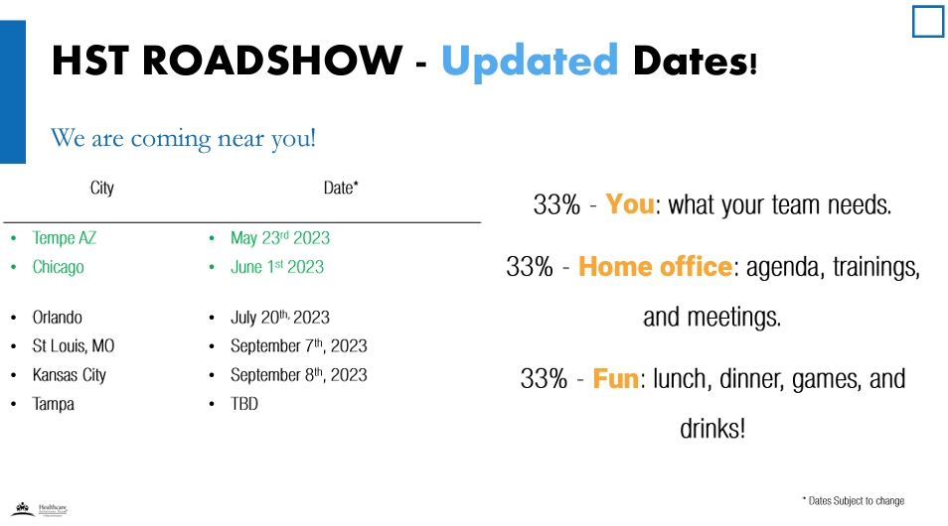

Slide 7
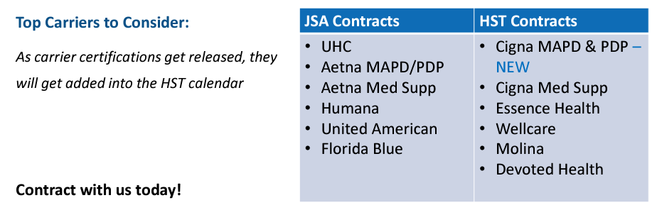

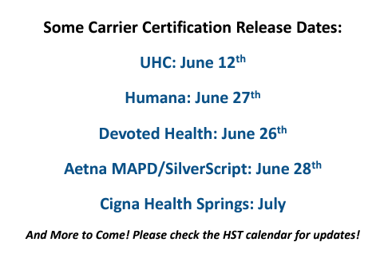
Medicare News JSA will provide agents a sponsored link for 2024 AHIP certification! Found on: www.jsamedicareahip.com The AHIP exam without a discount code is $175. If you take the exam through the link below or a carrier, you should only be asked to pay $125 2024 AHIP certification is being released on June 21st, only 9 days away!
If you are New to HST or NEW to Medicare and taking AHIP the FIRST TIME We are offering a ONE TIME reimbursement of $125 •We will reimburse $125 for your FIRST TIME taking AHIP. •REQUIREMENT: You must have 2 MAPD carrier contracts through HST are required for reimbursement. •Please send certificate and list what 2 MAPD contracts you hold with us to training@myhst.com for reimbursement.

Slide 8
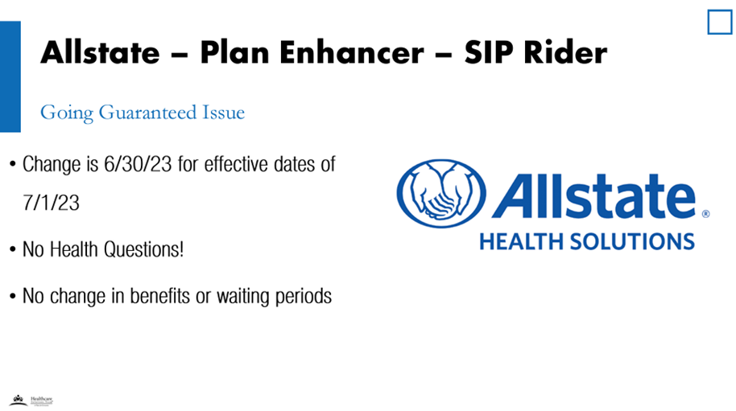
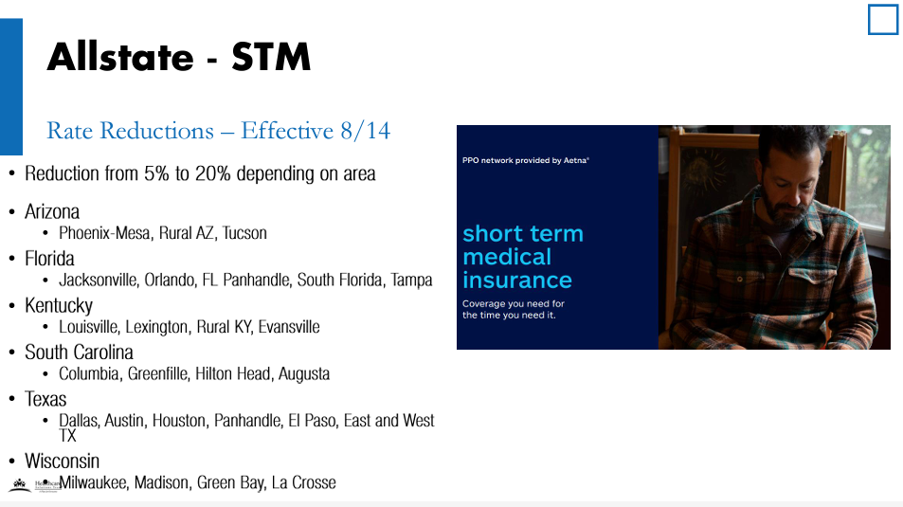


Slide 9
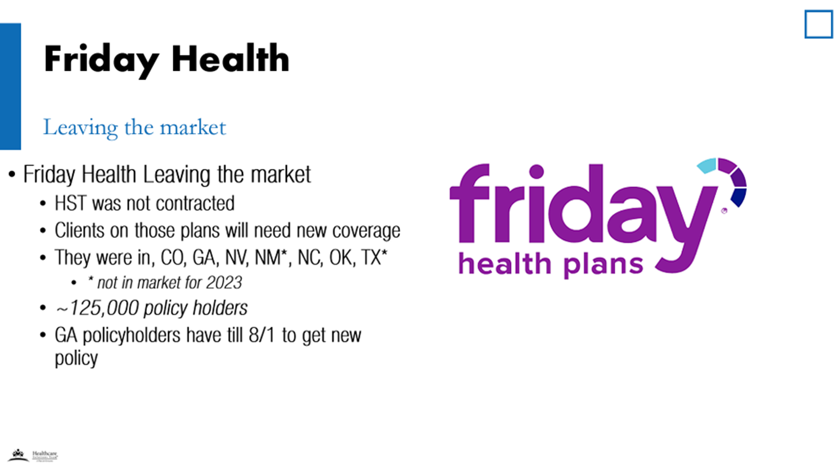
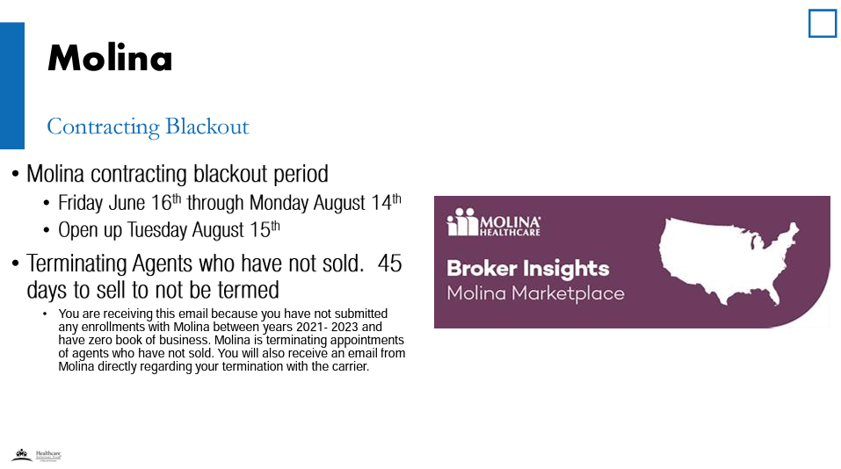

Slide 10

Allstate & HST have Finalized a Deal with Walmart
Healthcare Solutions Team & Allstate Health Solutions have worked on a deal with Walmart to have access to 4,000+ of their store locations to help shoppers with their health insurance needs.
Walmart has decided to give HST an exclusive first pick of stores they want to get into.
We will have the ability to talk to live customers, in the store, and help sell their health insurance, this is a great opportunity to help build your Book of Business.
REQUIREMENTS
The requirements for selling in Walmart stores will be as follows:
Must Dedicate 3 days per week for 20 Hours per week,
Uphold Ethical Sales Standards
Must Lead with ACA Products when Applicable
ACA Carrier Contracts MUST be with HST
Supplements CAN ONLY be through Allstate Health Solutions
Must Join Welcome Webinar
Must Complete Training Program
Allstate + Walmart Training
One of the requirements is that each agent who agrees to consult at a given store must go through a short training. This training will revolve around: products, carriers, sales tactics, Walmart's history, and Walmart requirements and/or SOPs.

Slide 11
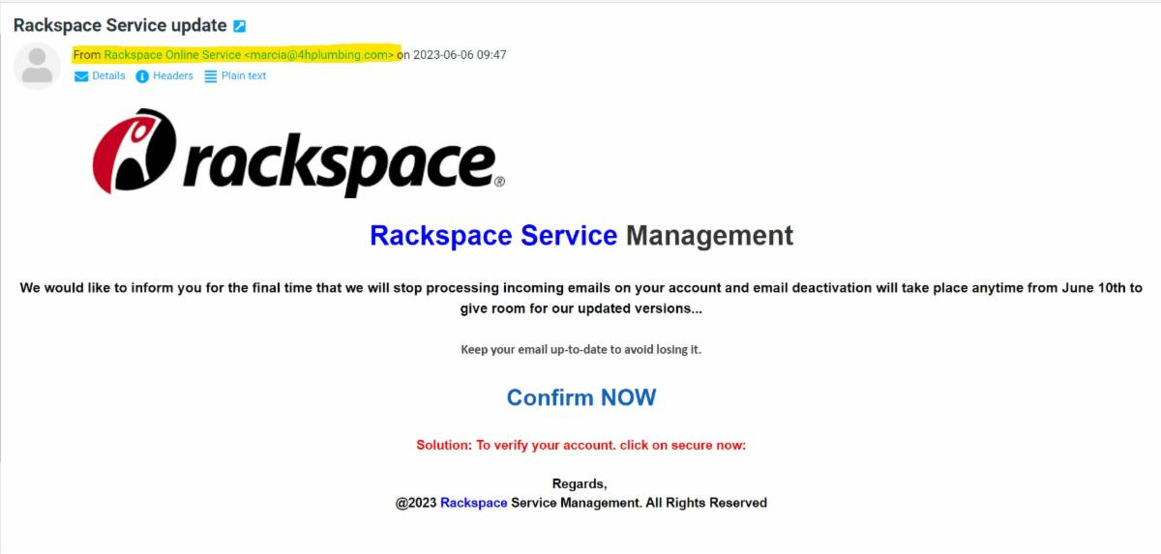
Please Be Diligent
Agents, As we roll through another year, we want to keep sending constant reminders to be hyper-diligent when clicking on emails. Due to the hack of Rackspace, hackers have our entire company list of email addresses and it will take a concerted effort to make sure we do not get hacked again. Moving forward, please mark ANY email from "Rackspace" as junk. This will help our server understand that these emails and anything from Rackspace are spam and to delete it before they ever make it to your inbox. Please READ the email address that suspicious emails are coming from. This does not mean the name given, but the actual email address. In a recent spam email, the name was listed as Rackspace Online Service but it was from marcia@4hplumbing.com. This is a common trick from hackers as a whole. If you do not see the email address when viewing emails, its here: Settings>Preferences>Displaying Messages>Show email address with display name Your Password will never "expire" or need to be "confirmed." Our hosting provider will not cut off your password at a given point. Hackers are trying to have you enter to your username and password so they can get into your account.
Watch Out for Scams & Hackers

Slide 12



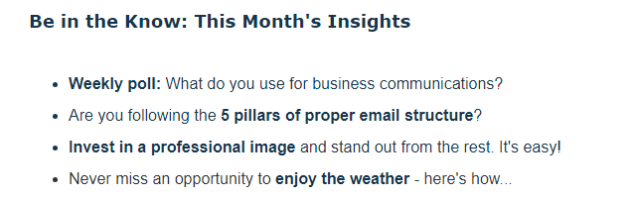
June 2023, Issue 7
June 2023, Issue 7
View as Webpage

Slide 13
CHC LEAD CREDITS

Slide 14



America's Choice
Plum Life
CHC ACA Contracting

Slide 15

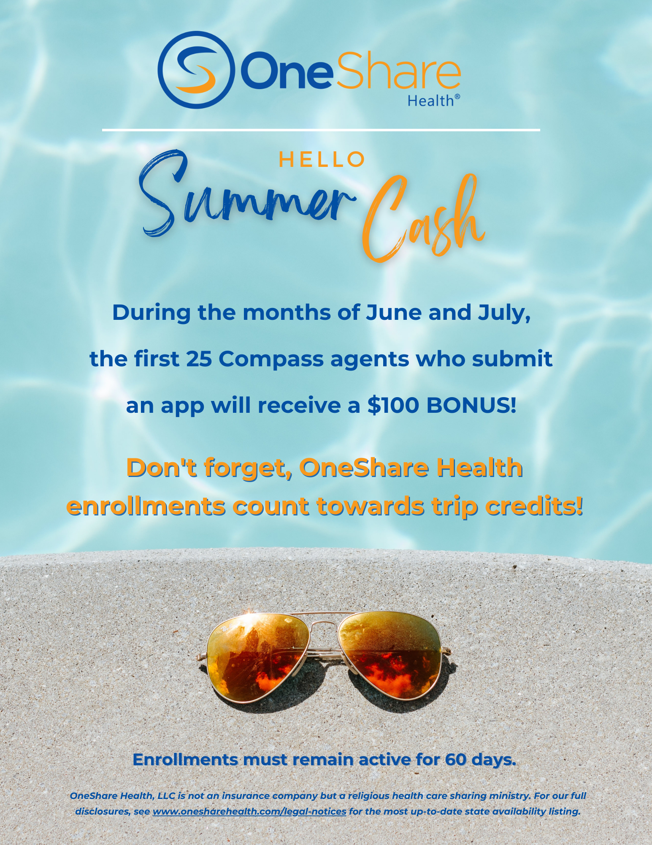


Slide 16



2023 2nd Quarter Allstate Bonus
Q2 Sales Goal 10 Million
$10,000 Total Bonus Payout
Point Value
(Multiplied by AV)
1 POINT
Short Term Medical
Cancer, Heart, Stroke
2 Points
Critical Illness
Accident
Fixed Benefit
Plan Enhancer
Dental PPO
TrioMed
Group
Life
15 DAYS LEFT
75% to Goal
For every 10 paid applications, agents will receive an entry for one of 2 $1000 drawings.
If the 20% Goal is not attained:
Top 2 Agents will receive $500
&
Second Chance Drawing will take place.
*Bonus will be split by the top 12 agents based on weighted % of business that each agent produced.
**Drawing will be held if the $10 Million goal is met. Top 12 Agents are not eligible for the $2000 Second Chance Drawing. Bonus will be paid at the end of July 2023.

Slide 17

Rank | Name | #Apps
1 | Phillip Vogt | 32
2 | Richard Hyde | 26
3 | Jennifer Earp | 24
4 | Dominic Bove | 23
5 | Michael McAllister | 22
6 | Lairah Seymour | 19
7 | Jamie Baumeister | 18
8 | Jeffrey Seymour | 18
9 | Brandon Halbert | 17
10 | Kim Kirsch | 17
Top 10 Agents This Month

Slide 18

CONGRATULATIONS AGENTS!
1ST APP
Agent | Mentor
Steven Torress | Philip Vogt
John Kaufman | Jordan Krugman
Trent Compton | Keith Cheverie
Katina Williams | Brian Drennon
Samantha Ramirez | Faith Bratlie
Yahaira Ramirez | Darcie Healy

Slide 19
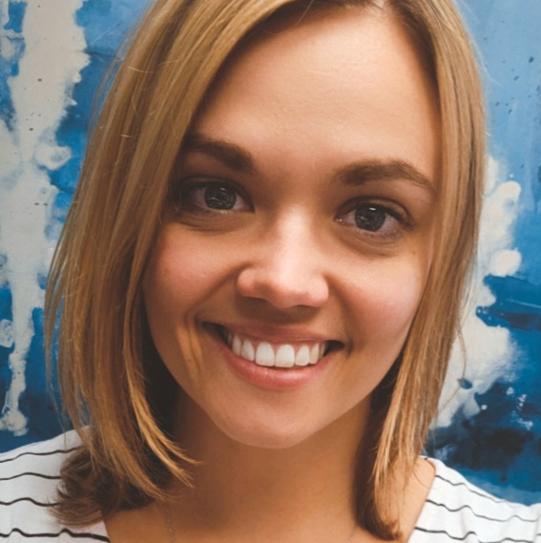
Welcome Morgan Saldana!
Special Projects Manager
Please take a moment to welcome our newest CHC staff member. She will not only handle the special events but will also handle TopBroker Billing.
She can be reached via email, msaldana@chcquotes.com.

Slide 20


Wishing you a wonderful time with your family as you celebrate Father’s Day.
-Joe Krivelow
The seven roles that a father plays in the life of his family: provider, protector, leader, teacher, helper, encourager, and friend. - Stephen Kendrick

