Slide 1
JK AGENT SALES TRAINING CALL
Thursday, September 1, 2022
1PM CST
Zoom Meeting Link: https://zoom.us/j/3738421209

Slide 2
Upcoming CHC Events & Training Please visit www.chcagents.com for the monthly CHC training calendar.
Weekly Trainings
Special Events
KickStart EVERY Tues, Wed, & Thurs, 8:30 AM CST
Sales Day Q & A! EVERY Tues, Wed, & Thurs, 5 PM CST
Agent Role Play EVERY Friday, 8:30 AM CST
TopBroker Training Every Tuesday, 1 PM CST
Sept 13th & 14th - New Agent Training – STL
Sept 16th & 17th - Nashville Team Training
Sept 24th - Super Saturday Training
Sept 27th & 28th - New Agent Training – Tampa

Slide 3
SPECIAL TRAINING EVENT
What: FFM Training for ACA Certification
When: Friday, September 2, 2022, 12 PM CST
Where: Zoom Meeting Link: https://zoom.us/j/3738421209
Who: Bill Pauley

Slide 4
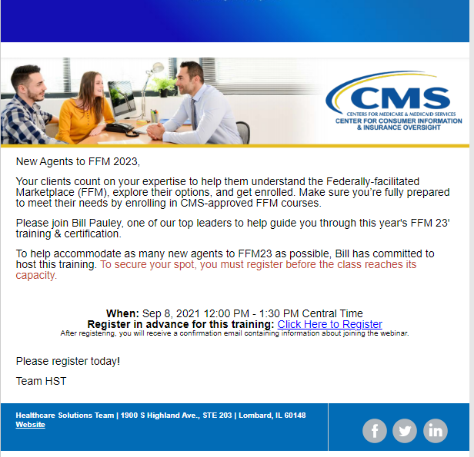
https://nationalgeneral.zoom.us/webinar/register/WN_xtFiv0xaSgCDSsy0s0RIig

Slide 5
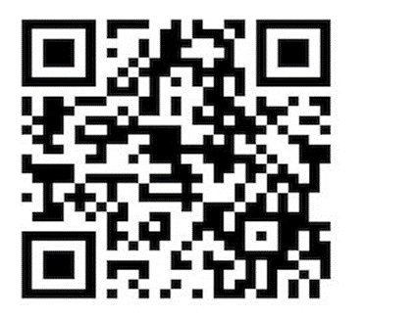
SPECIAL EVENT
Friday, September 16
8:30 AM – 9:30 AM
Health Insurance for Under 65 Landscape and its Future Joe Krivelow Healthcare Solutions Team Compass Health Consultants

Slide 6
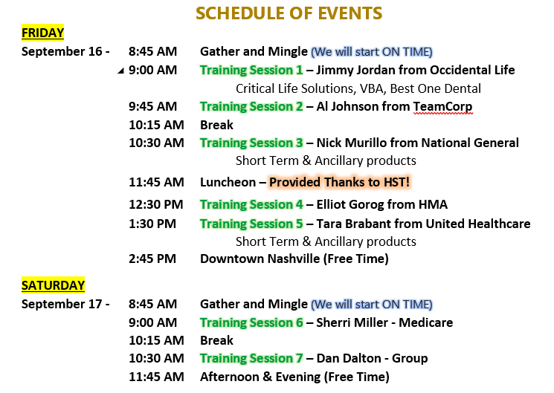
Please direct all questions to Bill Pauley, wpauley@myhst.com.

Slide 7
HST Leaders’ Meeting
August 2022
Presentation can be found on HST LeadMaster > HST Library.
https://hstleadmaster.com/

Slide 8
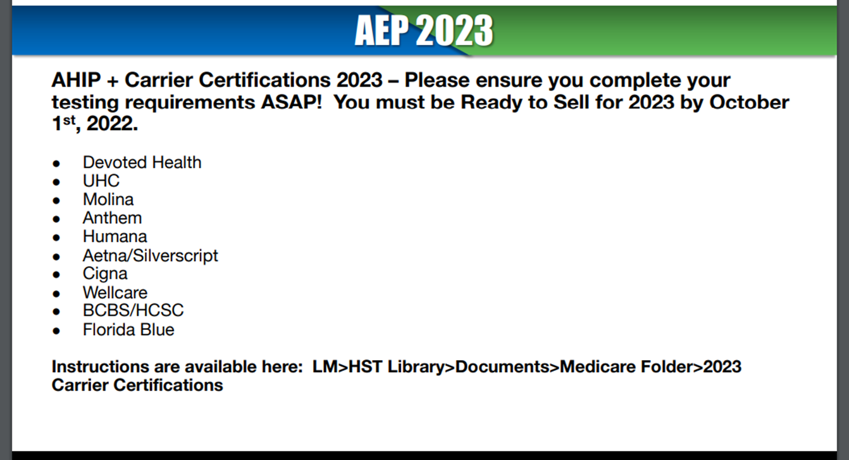
Plan Year 2023 Marketplace registration and training is now available for new agents and brokers and those returning who didn’t complete Marketplace training for Plan Year 2022! The SHOP agreement and optional SHOP training are also available.
https://portal.cms.gov/portal/
Need additional help? Contact the Marketplace Service Desk at 1-855-267-1515 Monday to Friday from 8:00 a.m.−8:00 p.m. ET.

Slide 9
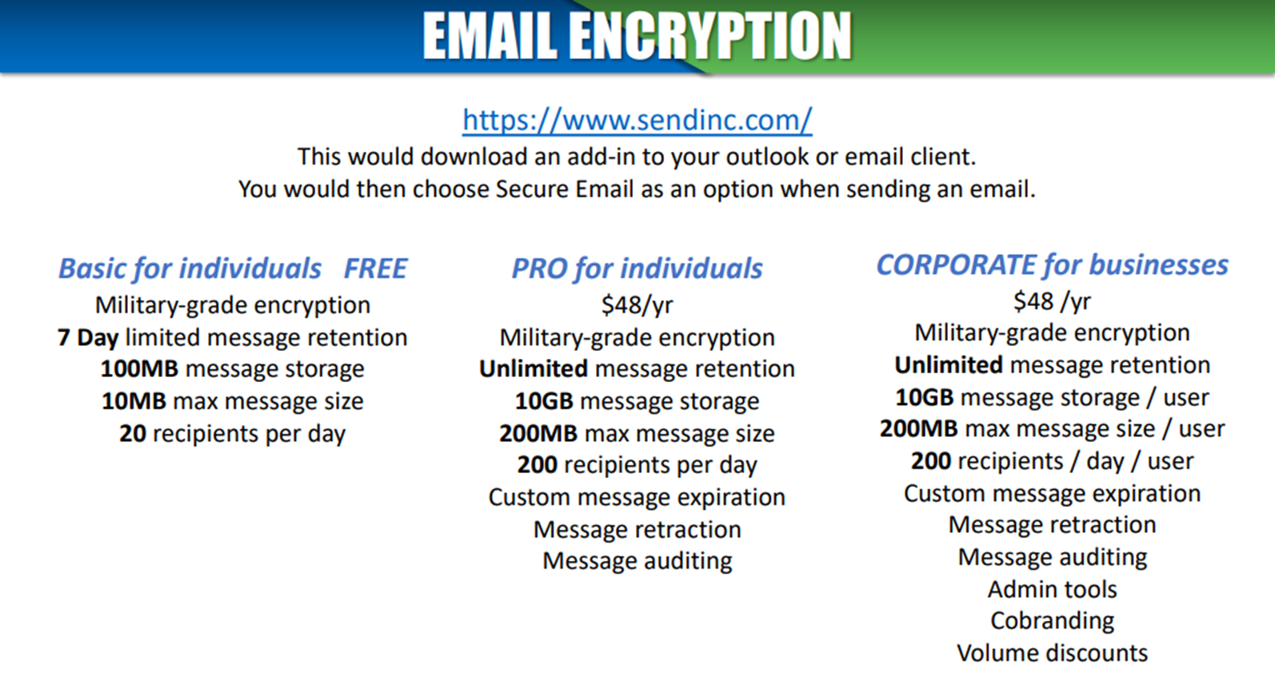
HST UPDATES
Don’t forget to join the HST Live Meetings and view the weekly HST Updates!
HST LeadMaster > https://hstleadmaster.com/

Slide 10
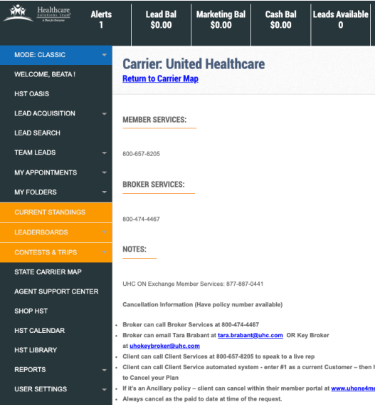

Slide 11
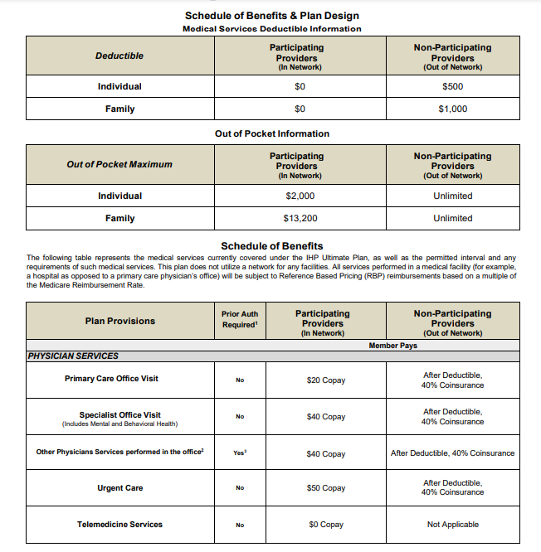
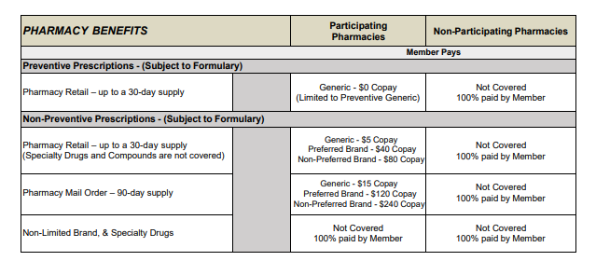
Entire SOB can be found on the Agency portal. www.chcagents.com.
For Contracting:
Email: tmosley@myhst.com
Please include Name, Phone# & Email. In the Subject Line - please put PHP Contracting Request.
PHP is now IHP in TopBroker!

Slide 12
Making Our Lives Easier!!! PHP IHP Plan Rolls Out Client APP!

Slide 13
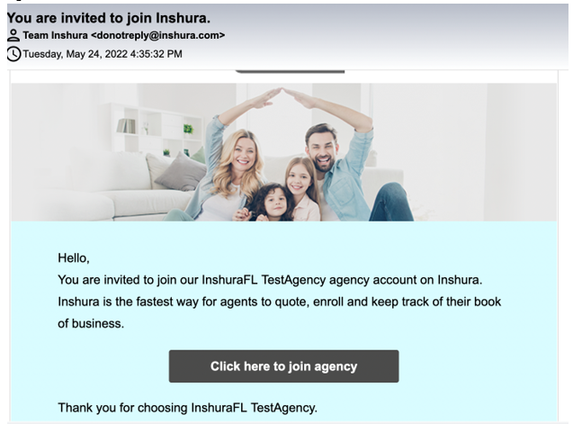
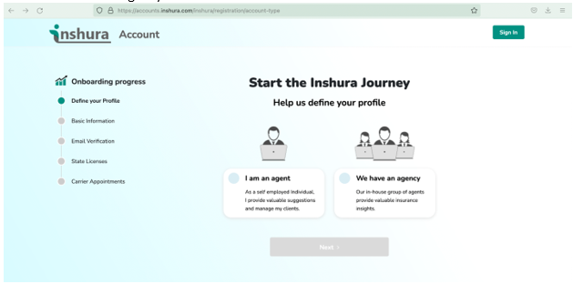
Inshura Onboarding

Slide 14
CHC Agency Contest - September 2022
IHP - Partnership Health Plan
5 – 9 Applications $50 per app
10 – 15 Applications $100 per app
15+ Applications $150 per app
****Bonus****
If the Agency has more than 150 applications for the month, all agent application bonus DOUBLES!

Slide 15
WELCOME BONUS
Newly contracted producers will have until December 31, 2022, once their onboarding and training has been completed for the opportunity to earn a $50 bonus per application that has an annual premium of $500 or more.
The maximum bonus amount per writing producer will be $1500 and will be paid as a lump sum on March 31st, 2023.
(EXAMPLE of BONUS: $500 of annual premium, writing agent will receive $50, $1500 of annual premium, writing agent will receive $150, $5000 of annual premium, writing agent will receive $500).

Slide 16
CHC Contest – Patriot Comprehensive Medical
Beginning Today, September 1st
Sell 3+ policies to receive $50 per application!
That’s It!

Slide 17
CHC August Contest Final Update Patriot Comprehensive Medical

Slide 18
CONGRATULATIONS

Slide 19
August 2022 Top Agents
Week-to-Date (Since 8/27/2022)
Top 10 Agents This Month

Slide 20
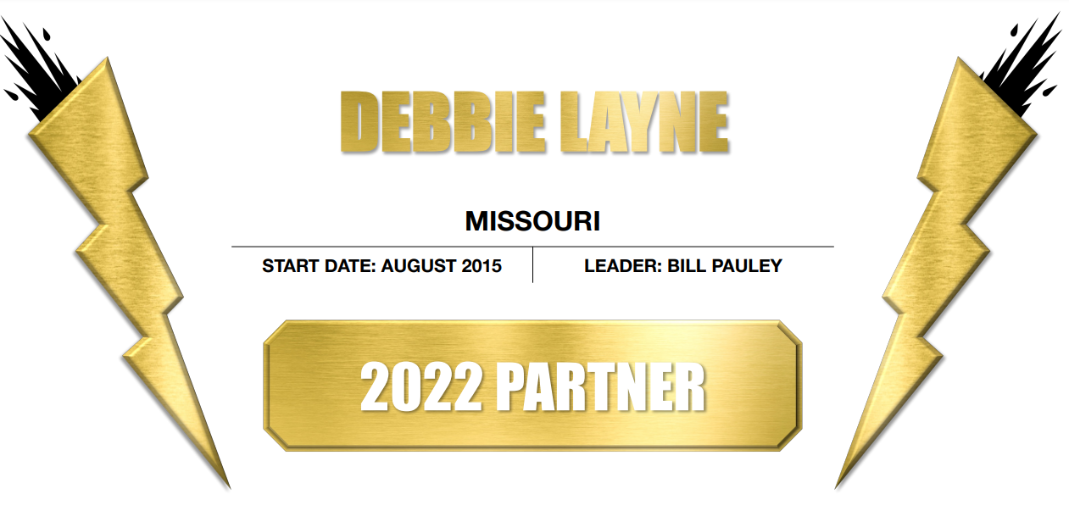

Slide 21
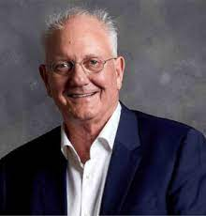
The highest-paid insurance agent is Gideon du Plessis. He earns an annual commission amounting to $70 million. A record he has maintained over the last 12-14 years, selling 700 policies yearly.
-Nov 1, 2021

Slide 22
Monday, September 5
Labor Day pays tribute to the contributions and achievements of American workers! Celebrating US!!

Slide 23
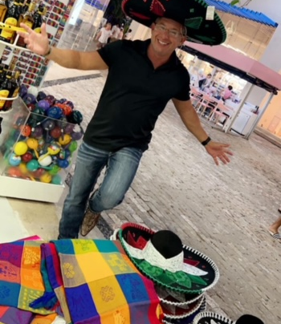
HAPPY 50TH BIRTHDAY!
Thank you for all the birthday wishes!
-Joe Krivelow

