Slide 1

JK Agent Sales Training Call
Thursday, October 13, 2022
1PM CST
Join Zoom Link:
https://zoom.us/j/3738421209

Slide 2


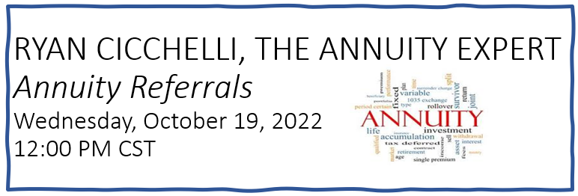
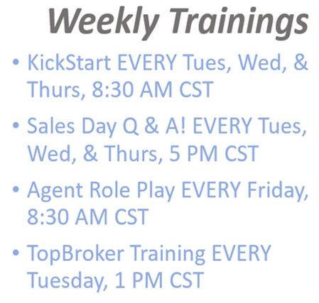

CHC
UPCOMING
TRAININGS
Amber Wise, Presenter
2:00 PM – 2:30 PM CST
ACA Bundling

Slide 3

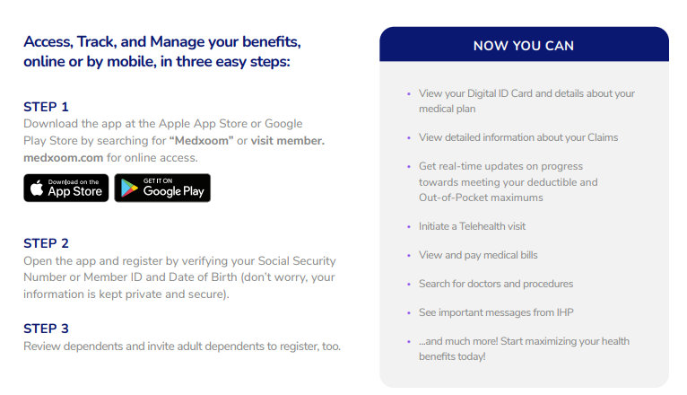
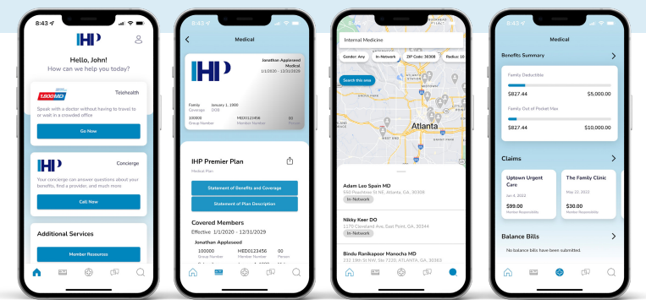
PAYROLL UPDATE
Moving forward, please expect PHP deposits the week of the 14th. The extra time is needed to receive our reporting and ensure accuracy, we don't want unexpected delays for anyone.
Data Entry Update
Recently, applications have been submitted with incorrect information such as names, email addresses, and other client-based info. This has caused some issues for the clients and the carrier, when attempting to access the policy. Please ensure you are entering your client info accurately.

Slide 4




Open Enrollment for 2023 runs November 1, 2022–January 15, 2023.

Slide 5

COMPASS HEALTH CONSULTANTS
Dental, Vision, Life
Ameritas
NCD
BestOne
UHC
National Life Group
Great Western
SBLI
Hero Life (New)

Slide 6
TopBroker Leads & Lead Credits
Lead Types
Lead Age
Credits
Daily Cap
Option
***Compass Aged
< 6 months
FREE
20
Click-To-Dial
***Compass Medicare
Real Time
20
Unlimited
N/A
***Compass Premier
Real Time
15
Unlimited
N/A
***Compass Telemarketed Leads
Real Time
20
Unlimited
N/A
***Fresh Lead
Up to 90 days
FREE
50
N/A
***HST Aged Leads
< 1 year
FREE
50
Click-To-Dial
***JK Exclusive Leads
24 - 72 hours
FREE
5
N/A
Pacific Life
$25
Philadelphia American
$25
Protective
$25
SBLI
$25
SBMA Group MEC
$25
Sons Of Norway
$25
UHC All Savers CHC Group Business
$25
Asteya
$25
Patriot Comprehensive Medical
$25
IHP Innovative Health Plans
$50
IHP Innovative Health Plans Group
$100

Slide 7

CHC Business Tool – VA Virtual Assistants
Dedicated VA's will work with you regularly as you delegate tasks during their 40-hour work week.
Having a VA will buy back your time to do what you do best, Help Others, CLOSE DEALS and make more Income.
5 Days
40-hour week
$800 a month
$150 Upfront Deposit to secure your VA
Weekends Available
Call Leads
Screen Leads
Live Transfers
Schedule Appointments
Confirm Appointments
Marketing
For More Information contact Kate
1-(561) 835-5578
contact@beyondvirtualagentcenter.com
www.beyondvirtualagentcenter.com

Slide 8


CHC Virtual Assistants
Text Drip Campaigns
Daily Lead Calls
**New** Call Rails
For $53.95/month
Funnel leads to all your agents. First one to answer, gets the lead.
Please email, Joe Krivelow or Tanya Mosley for details.

Slide 9
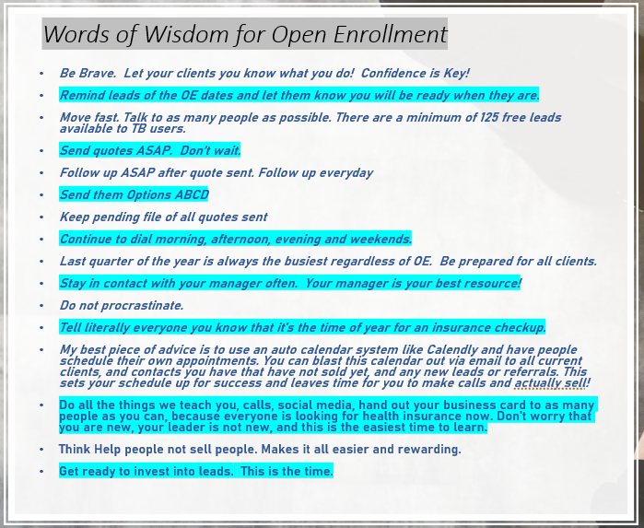
HST ACA Updates
HST Friends,
Bright HealthCare announced yesterday that they will be exiting the Individual U65 Marketplace in all of their states for the 2023 plan year.
Don't lose your Book of Business! Now is the time to get contracted with other top carriers to protect your clients and Healthcare Solutions Team is here to help you!
Please be sure to reach out to your leader for additional questions or follow instructions below on how you can become contracted with state specific ACA carriers.

Slide 10






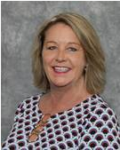
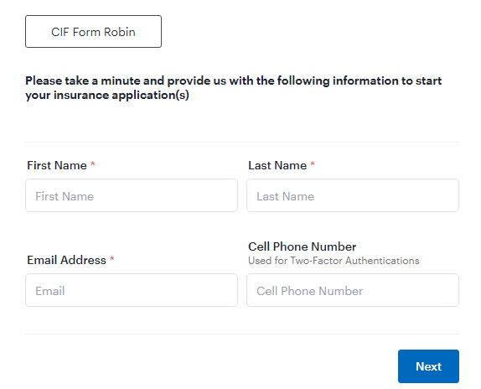
CHC
Open Enrollment Referral Program
ACA Referral Program
Send client info to acareferral@chcquotes.com
Agent will be paid $100 per submission.
Medicare Referral Program
Send client info to medicarereferral@chcquotes.com
Agents will be paid $100 per submission.
*The more information provided for a client, increases the likelihood of a sale and referral payout.
FL Blue Referral Program
Use the following link to create your referral. https://meadowbrook.useindio.com/sign-up/K3M30Zg4dLC8_WkU8qu5
Submission Response:
Thank you for your referral, it is much appreciated. Please allow 24-48 hours for a response. Complete the link below with the client’s information and please respond to this email with all necessary supporting documents. Should you have any questions, please feel free to reach out to me.
Robin Deck Hutchison
Personal Lines Agent
941-376-8460 Work
941-724-8856 Fax
Robin.deck-hutchison@meadowbrook.com

Slide 11

TOP 10 AGENTS SEPTEMBER 2022
Rank | Name | #Apps
1 | Phillip Vogt | 57
2 | Tim McCormick | 52
3 | Jeffrey Seymour | 51
4 | Jennifer Earp | 48
5 | Faith Bratlie | 45
6 | Lairah Seymour | 43
7 | Janet Rhonehouse | 39
8 | Richard Hyde | 37
9 | Janine Mistretta | 34
10 | Justin Rubenstein | 31

Slide 12


CHC Contest Announcement
IHP – Innovative Health Plans
November & December 2022
7 – 10 Applications $50 per app
20 - 25 Applications $100 per app
25+ Applications $150 per app
11 – 19 Applications $75 per app

Slide 13

1st APPLICATION
Agent | Manager
Amir West | Emmanuel Hotya
Carla Brock | Kimberly Stevens
Latarsha Billingsley | Faith Bratlie
David Henson | Brian Dixon
Taylor Smelser | Brian Dixon

Slide 14


Welcome Ryan Ciccelli, The Annuity Expert

