Slide 1
COMPASS HEALTH CONSULTANTS
JK Agent Sales Training Call
Thursday, October 27, 2022
1PM CST
Join Zoom Link: https://zoom.us/j/3738421209

Slide 2
COMPASS HEALTH CONSULTANTS TRAINING & EVENTS
ACA Open Enrollment November 1st – January 15th
Virtual HST New Agent Training November 15th & 16th
JK Agent Sales Training Call November 17th
JK Weekly Open Enrollment Follow-up Every Wednesday, 8:30 AM CST
TopBroker Training Every Tuesday 1PM
CHC Support
Agent Portal, www.chcagents.com
Leads/Lead Referrals/Billing, Peggy Doherty, pdoherty@chcquotes.com
Payroll & Commissions, Christina Kluber, payroll@chcquotes.com
CHC Carrier Sales, Kent Stansfield, kstansfield@chcquotes.com
CHC Carrier Contracting & TopBroker, Tanya Mosley, tmosley@chcquotes.com
CHC Group Sales, Bill Morrissey, groupquotes@chcquotes.com
Compass Health Consultants Founder Joe Krivelow, jkrivelow@chcquotes.com.

Slide 3
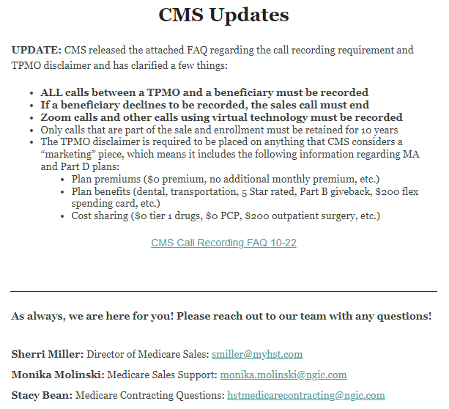
Family Glitch
Beginning in 2023, if a consumer has an offer of employer-sponsored coverage that extends to the employee’s family members, the affordability of that offer of coverage for the family members (of the employee) will be based on the family premium amount, not the amount the employee must pay for self-only coverage. Since the IRS’s new regulations take effect for Plan Year 2023, consumers will see changes to the 2023 Marketplace application when Open Enrollment begins on November 1, 2022.​

Slide 4
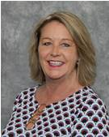
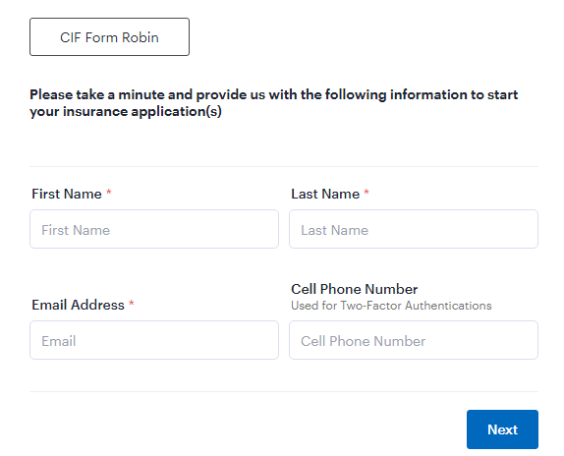
CHC Open Enrollment Referral Program
ACA Referral Program
Send client info to acareferral@chcquotes.com
Agent will be paid $100 per submission.
Medicare Referral Program
Send client info to medicarereferral@chcquotes.com
Agents will be paid $100 per submission.
*The more information provided for a client, increases the likelihood of a sale and referral payout.
FL Blue Referral Program
Use the following link to create your referral. https://meadowbrook.useindio.com/sign-up/K3M30Zg4dLC8_WkU8qu5
Submission Response:
Thank you for your referral, it is much appreciated. Please allow 24-48 hours for a response. Complete the link below with the client’s information and please respond to this email with all necessary supporting documents. Should you have any questions, please feel free to reach out to me.
Robin Deck Hutchison
Personal Lines Agent
941-376-8460 Work
941-724-8856 Fax
Robin.deck-hutchison@meadowbrook.com

Slide 5
CHC Business Tool – VA Virtual Assistants
Dedicated VA's will work with you regularly as you delegate tasks during their 40-hour work week.
Having a VA will buy back your time to do what you do best, Help Others, CLOSE DEALS and make more Income.
5 Days
40-hour week
$800 a month
$150 Upfront Deposit to secure your VA
Weekends Available
Call Leads
Screen Leads
Live Transfers
Schedule Appointments
Confirm Appointments
Marketing
For More Information contact Kate
1-(561) 835-5578
contact@beyondvirtualagentcenter.com
www.beyondvirtualagentcenter.com

Slide 6
Agents currently have access to Humana group Dental Vision and life If they have 100 per month in Compass revenue. Starting Jan1st, we will have Access to IHP Group health. (As long as we have 5 participants) Compass will Contribute $100 per month.

Slide 7
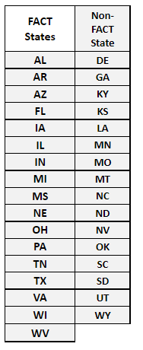
FACT and Non-FACT States UHC STM
1. All FACT states have first dollar coverage for colonoscopy, whether it's diagnostic or preventive, even if polyps are found, there is no cost except for pathology. Seems like a pretty big deal. List of FACT states below
2. Their Urgent Care copay has been reduced to $50 and it is all-inclusive no matter what the coinsurance is. Everything is covered for that $50 - tests, xrays, etc, as long as it is done at the network Urgent Care center.
3. Now that Nat Gen increased the deductibles to 7500 minimum in TN, we may want to look at UHC instead. No changes have been made to their STMs in TN.

Slide 8
CHC Contest Get Your Agent ID & Enrollment Link Today!
IHP – Innovative Health Plans
November & December 2022
7 – 10 Applications $50 per app
20 - 25 Applications $100 per app
25+ Applications $150 per app
11 – 19 Applications $75 per app

Slide 9
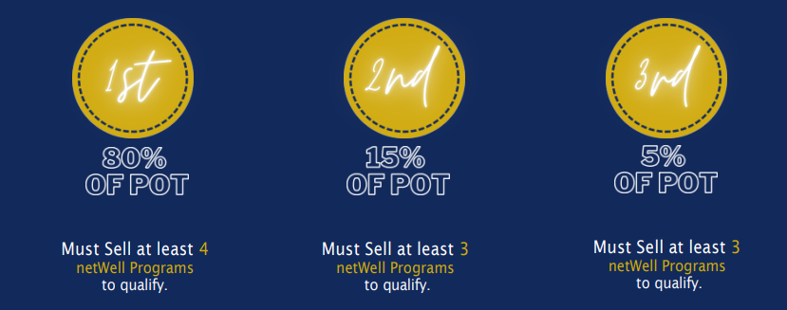
ATTENTION CONSULTANTS!! CONTEST ALERT!
We, at BMA, want to reward our Marketers who sell the highest number of netWell programs*, by giving CASH PRIZES!
*With program effective date no later than November 7, 2022
HOW IT WORKS
For every program Compass Health Consultants Proud Partner of Healthcare Solutions Team sells September 12, 2022, through October 31, 2022, $20 will go into a "pot".
At the end of the contest period, the Money Prize will be distributed, to qualified Marketers.
(Example: Company Sells 50 Programs = $1,000 in the Pot)
ADDITIONAL INFO In the event of a tie in number of netWell programs sold, winner will be determined by largest membership contribution amount.

Slide 10
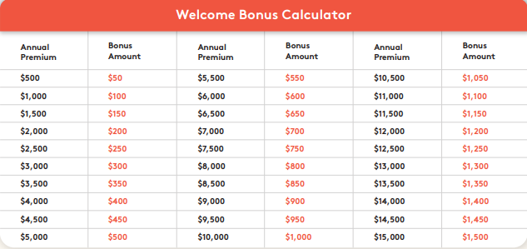
Welcome Bonus
Newly contracted producers/brokers are eligible for a Welcome Bonus, once their onboarding and training has been completed.
Please see the table below to see how much can be earned.
The maximum bonus amount per writing producer will be $1500 and paid as a lump sum on March 1, 2023.
EXAMPLE of BONUS: If the writing producer achieves $500 of the premium by the end of the year, they will receive $50, if however, they write $30,000 in premium, the writing agent will receive $1,500.
Will have until December 31, 2022, to write premiums.
To qualify for payment by March, the persistency ratio should be more than 70%.

Slide 11
1ST Application
CONGRATULATIONS
AGENT | MANAGER
Jamie Brink | Kimberly Stevens
Anna Medrano | Kim Kirsch
Josie Mescallado | Brian Dixon
Zandrae Mosley | Faith Bratlie
Rohan Beckford | Ghaleb Zayed
Matthew Platnico | Anthony McLaughlin
Jessica Mealer | Phil Vogt

Slide 12
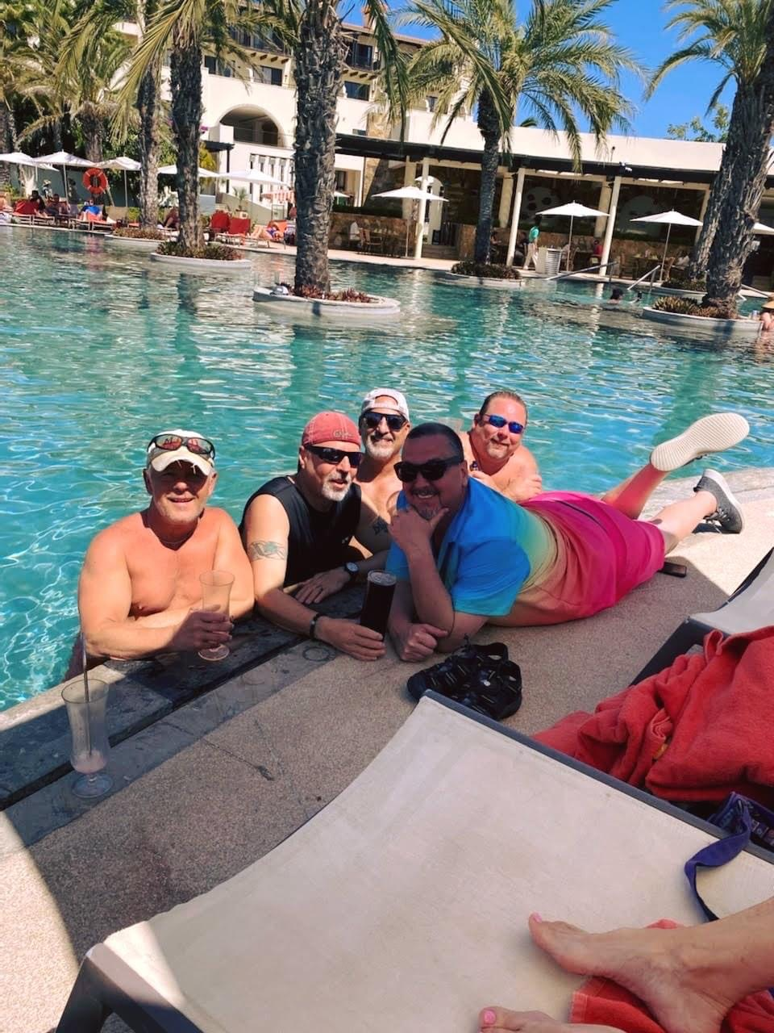
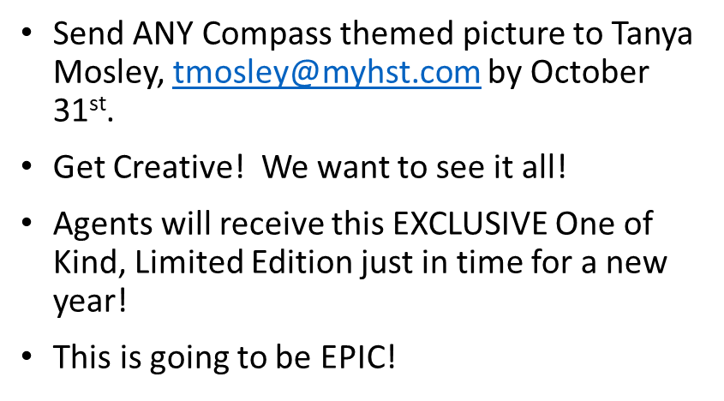
CHC 2023 CALENDAR!
CHC 2023 Calendar Project

