Slide 1
Medicare marketing

Slide 2
agenda
Current Book of Business
Direct Mailers
Seminars
Events
Different Targets
Networking
Contacts

Slide 3
Current book of business
Ensure that you are capturing your aging-in business.
Call all current members.
Let everyone know that you also sell Medicare Health Plans and would love to help.
Ask your U65 book for referrals.
Lists of your Aging-in T65’s can be pulled from your LeadMaster account.

Slide 4
Current book of business
Marketing is working best at 8 – 9 months prior to 65.
Set an appointment 3 months prior.
Remind them to ignore commercials/direct mail – you can simplify all of it for them and help them choose the best plan for their situation.

Slide 5
Direct mailers
Create your own personalized postcard!
Creates a personal fees
Add in family photo, company logos etc.
Advertise you are local to their market
Keep it educational only
Get all pieces approved by compliance prior to sending at compliance@jsaonline.com

Slide 6
Direct mailers
Utilize JSA Pro Shop Plus & Prospect List:
Download Prospecting List (up to 9 months out – turning 65)
https://arc.jsaonline.com/prospects
Create Flyers & PostCards
Schedule Direct Mailers out from ProShop Plus
..\..\HST - Miscellaneous\JSA ProShop Plus\JSA ProShop Plus Direct Mailers guide.pdf

Slide 7
PROSHOP PLUS mailers
Once approved, go back to your project and Order your prints

Slide 8
PROSHOP PLUS mailers
If you would like to ship the postcards to yourself first, Click on Ship.
If you would like to have your postcards, stamped and ship out to your Prospect List, Click on Mail.

Slide 9
PROSHOP PLUS mailers
This will bring you to a new page and this is where you can upload your Prospect list.

Slide 10
PROSHOP PLUS mailers
Double check you’re that the names, addresses, etc. are all in the right places, then click NEXT.
Wrong
Wrong

Slide 11
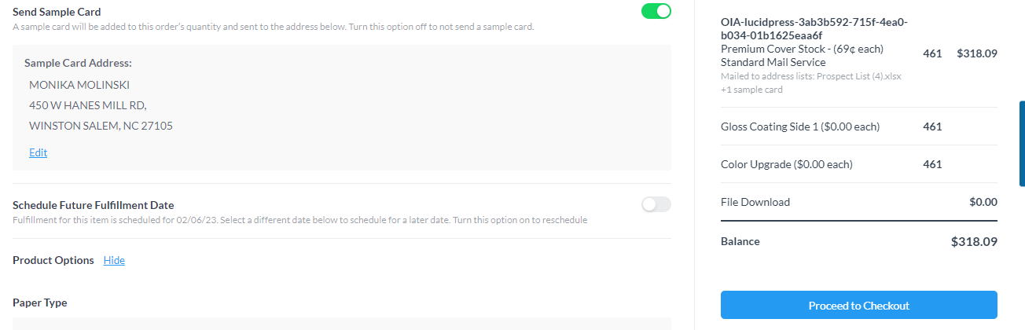
PROSHOP PLUS mailers
Your Excel file will then be processed and exclude the invalid addresses from your order to avoid any “Return to Sender.” Once Processed Proceed to Checkout.
Valid
Invalid

Slide 12
Direct mailers
Personalize your own generic, educational only mailer.
Ensure that anything created on your own is pre-approved by compliance.
Email your piece to compliance@jsaonline.com- typically a 24-hour turnaround time.

Slide 13
Social Media
In addition, our HST Marketing Team also has created educational social media images for you to use!
https://www.hstmarketing.com/social-media-images/

Slide 14
Social Media
JSA ProShop Plus also has educational social media images at: https://arc.jsaonline.com/proshop

Slide 15
seminars
Start with Educational
Can be formal or informal, depending on the type of setting. For example:
Formal: Medicare 101 presentation
Informal: Medicare Q&A booth at Heritage Festival
Then move into Marketing Events
Set up a private 1:1 to discuss details/compliance.
Most carriers will allow you to do formal sales events in your local market.

Slide 16
Events
Contact event coordinators at Senior Centers, Community Centers, Senior Living facilities, etc., and see if you can be a part of their event.
Other locations to consider:
Mom & Pop Shops: Restaurants, Barbers/Hairdressers, & Cafés
Farmers’ Markets
Libraries
Grocery Stores: Walmart, Kroger, etc.
Gyms, through Silver Sneakers
Garden clubs, Ski clubs, Bowling leagues, car show, etc.

Slide 17
events
Need ideas?
Events hosted in the past:
Ice Cream Socials
BINGO, Scrabble, and other Sports & Gaming events
Parades and local picnic/social events, like Heritage festivals, music, farmers’ markets

Slide 18
Events
Good websites to use:
Eventbrite
www.eventbrite.com
Senior directory
www.seniorcenterdirectory.com
Senior activities near area (Google search)
Example: https://www.cityofoviedo.net/711/Senior-Activities

Slide 19
Events
New website to support events:
HST 1099 Medicare Site (orderpromos.com)
Pens, bags, table cloths, pop up banners, etc.

Slide 20
Different targets
VA
Be a part of their community – Volunteer
Local food & clothing drives, Annual Veteran’s & Memorial Day Events, VA Community Living Centers
Dual Population
Food pantry
Networking groups – Get more involved!
Chambers of commerce
BNI
Senior Marketing Groups
Financial Advisors

Slide 21
networking
Network! Offer to educate and trade business referrals:
Financial planners
P&C agents
Elder Law attorneys
State Farm offices
Provider offices
Medicare Disability attorneys/offices

Slide 22
AHIP 2024
Launches June 21^{st.}
www.yourmedicareahip.com, should ask to pay $125.
Carrier certifications will launch after, should also have a $50 discount

Slide 23
Contacts
Sherri Miller, Director of Medicare Sales
E: smiof@allstate.com C: 309.267.6164
Monika Molinski, Support Associate, Medicare Sales
E: monika.Molinski@ngic.com OR mmols@allstate.com C: 708.506.4761
Stacy Bean, Medicare Contracting
E: hstmedicarecontracting@ngic.com
Adriana Rock, Medicare Leads
E: Adriana.Rock@ngic.com
JSA: 800.203.0433
Contracting/adding states: contracting@jsaonline.com
Compliance: compliance@jsaonline.com

