Slide 1

JK Agent Sales Training Call
Thursday, September 15, 2022
1PM CST
Zoom Meeting Link: https://zoom.us/j/3738421209

Slide 2
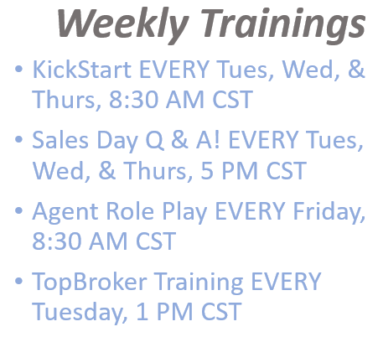
Important Dates
HST & CHC
CHC Important dates:
Sept 16th & 17th - Nashville Team Training
Sept 22 Compass Training: Group Sales Bill Morrissey
Sept 24th - Super Saturday Training
HST Important dates:
"All Hands” HST Open Enrollment Kickoff Meeting: Monday October 3, 2022
Medicare Open Enrollment: October 15 – December 7
ACA Open Enrollment Period: November 1 – January 15, 2023 (most states)

Slide 3

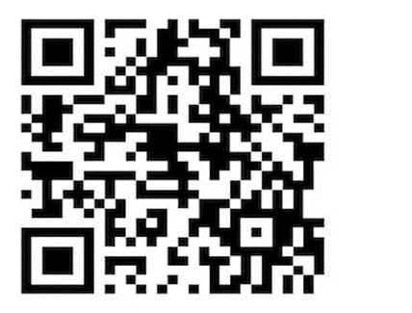

SPECIAL EVENT
Friday, September 16
8:30 AM – 9:30 AM
Health Insurance for Under 65 Landscape and its Future
Joe Krivelow
Healthcare Solutions Team
Compass Health Consultants

Slide 4
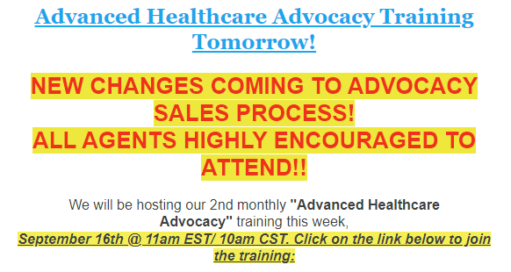
CHC CARE – HEALTHCARE ADVOCACY
We will be announcing NEW changes to advocacy that agents will need to know about. We highly encourage all agents to attend this training. New changes will require agents to know the new sales process in order to approve new enrollments into advocacy.
Please join us so you don't miss out on getting member approved and paid out on your commissions.
We look forward to seeing you all this Friday, as we're all getting geared up to have an extremely successful Open Enrollment this year!!

Slide 5


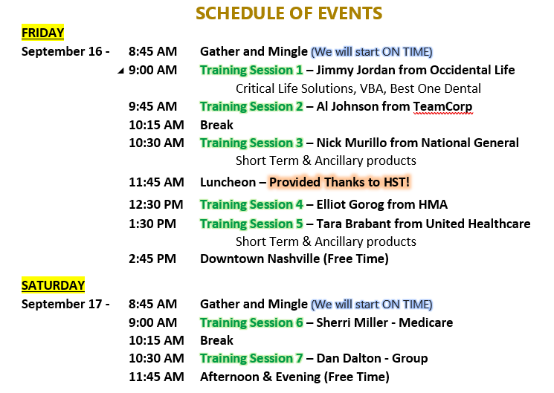
Please direct all questions to Bill Pauley, wpauley@myhst.com.

Slide 6

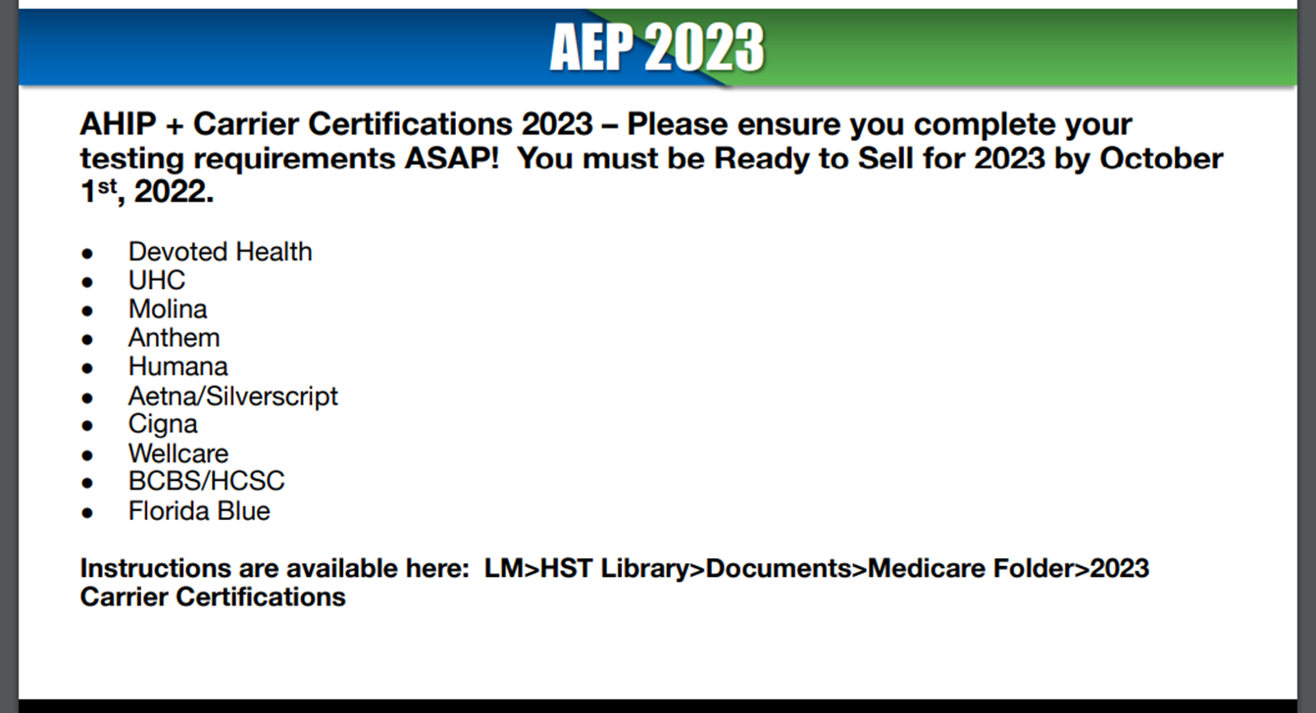

Plan Year 2023 Marketplace registration and training is now available for new agents and brokers and those returning who didn’t complete Marketplace training for Plan Year 2022! The SHOP agreement and optional SHOP training are also available.
https://portal.cms.gov/portal/
Need additional help? Contact the Marketplace Service Desk at 1-855-267-1515 Monday to Friday from 8:00 a.m.−8:00 p.m. ET.

Slide 7
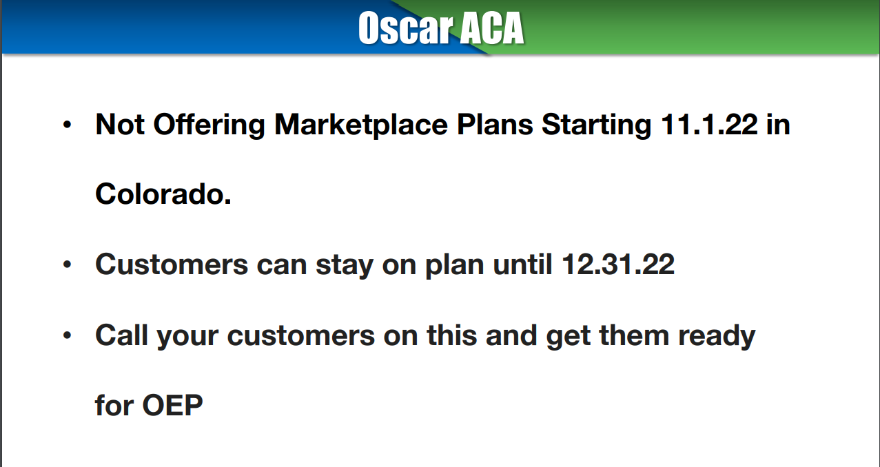

Slide 8

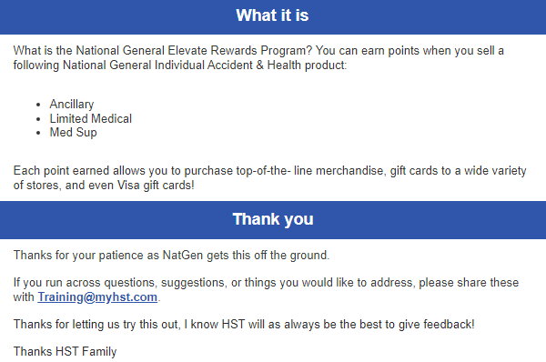
Last week NatGen sent a welcome email to their new program to us at HST and HST's email server blocked a large number of the invites! If you DID NOT receive the invite, please follow the steps below. 1. Download the Elevate Rewards App. The mobile app is available on you app store. Apple https://apps.apple.com/us/app/natgen-elevate-rewards/id1621104432 Google https://play.google.com/store/apps/details?id=natgen.elevate.rewards 2.Register. Upon opening the app your user ID is your email on file with National General, your @myhst.com To create your password, click “Forgot Password?” You will receive an email with a link to set up a password to the Elevate Rewards Program. 3.What should I do if I receive an error when I log in? Please call NatGen Agent Services 888-376-3300
Update

Slide 9
CHC Exclusive Carrier Updates
EBA – Current standing
NCD – Newest Dental Product
Contracting updated
https://ncd.com/agents
Video on the above link
Nobody touches NCD on commissions
  Paid weekly for new business and monthly for renewal
  Frequent sales contests
Nobody touches NCD on Member Care
Nobody touches NCD on Agent Support
Over 250k docs at over 600k access points
  20-40% off billed charges before coinsurance is applied
Waiting period can be waived with prior coverage
Preventive and Basic available day 1
Implants can be covered
Nationwide brand
Same rate in every state
$1500, $3000, and $5000 max options (per client)
IHP (Innovative Health Plan) Formerly PHP (Partnership Health Plan) - IHP disruption. Eligibility system went completely down, therefore the standard process of eligibility was interrupted. We understand the issues this has caused for so many and have put systems in place to assure this doesn’t happen in the future. We appreciate everyone's patience as we are still working to make sure all data is correct and functioning to its full capacity.

Slide 10



CHC Open Enrollment Referral Program
Agents will be paid a referral fee of $100 per lead supplied.
We encourage you to complete your own sales to grow your business and earn commission and credit.
Please direct any questions to Peggy Doherty.

Slide 11


Do use www.chcagents.com for all contracting, commissions, brochures.
Do email appropriate persons for inquiries.
Do use a signature line.
DO NOT SHARE SALES! AGENTS SHOULD BE WRITING THEIR OWN BUSINESS!
Keep TopBroker Active by using the system daily. TopBroker is deactivated if there is limited or no activity in a 2-week time period.

Slide 12

CHC
Contact List

Slide 13


CHC Contest – Patriot Comprehensive Medical
Starts September 1st
Sell 3+ policies to receive $50 per application!
That’s It!

Slide 14



ATTENTION CONSULTANTS!!
CONTEST ALERT!
We, at BMA, want to reward our Marketers who sell the highest number of netWell programs*, by giving CASH PRIZES!
*With program effective date no later than November 7, 2022
HOW IT WORKS
For every program Compass Health Consultants Proud Partner of Healthcare Solutions Team sells September 12, 2022, through October 31, 2022, $20 will go into a "pot".
At the end of the contest period, the Money Prize will be distributed, to qualified Marketers.
(Example: Company Sells 50 Programs = $1,000 in the Pot)
ADDITIONAL INFO In the event of a tie in number of netWell programs sold, winner will be determined by largest membership contribution amount.

Slide 15

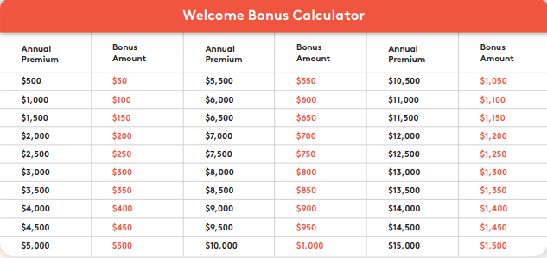

Welcome Bonus
Newly contracted producers/brokers are eligible for a Welcome Bonus, once their onboarding and training has been completed.
Please see the table below to see how much can be earned.
The maximum bonus amount per writing producer will be $1500 and paid as a lump sum on March 1, 2023.
EXAMPLE of BONUS: If the writing producer achieves $500 of the premium by the end of the year, they will receive $50, if however, they write $30,000 in premium, the writing agent will receive $1,500.
Will have until December 31, 2022, to write premiums.
To qualify for payment by March, the persistency ratio should be more than 70%.

Slide 16



CHC Agency Contest - September 2022
IHP - Partnership Health Plan
5 – 9 Applications $50 per app
10 – 15 Applications $100 per app
15+ Applications $150 per app
****Bonus****
If the Agency has more than 150 applications for the month, all agent application bonus DOUBLES!

Slide 17

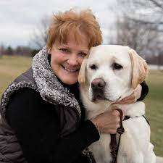
HST ANNIVERSARY
9/8: Susan Weick (MO) 14 Years

Slide 18

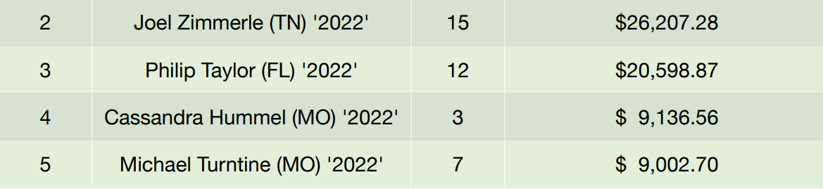
4 out 5 Top Rookie Performers!
Great Job!
Healthcare Solutions Team

Slide 19


1ST APP SOLD

Slide 20


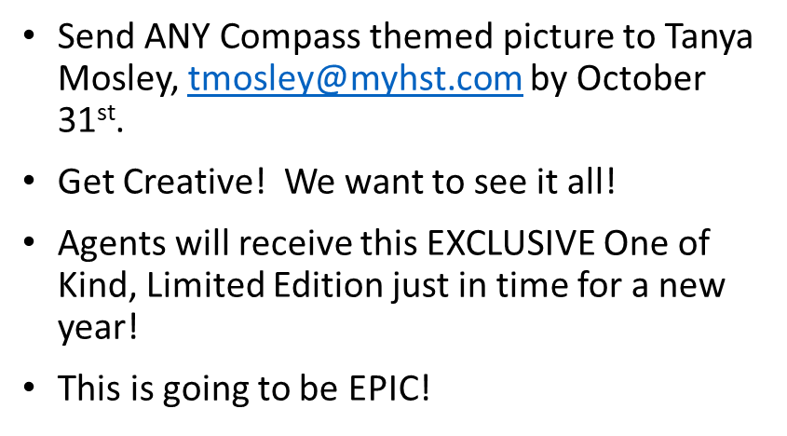
CHC 2023 CALENDAR!
Coming December 2023!
CHC 2023 Calendar Project

Slide 21


“That idea is so fantastic. Stop talking about it and do it.”
Together is Better by Simon Sinek

