Slide 1
JK Agent Sales Training Call
Joe Krivelow, Founder
Thursday, January 26, 2023
1:00 PM Central
Zoom Meeting Link
https://zoom.us/j/3738421209

Slide 2
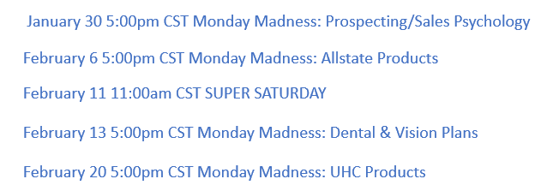
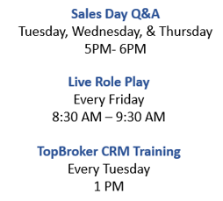
Philadelphia American
Text Drip Campaigns
COMING SOON!

Slide 3
HST 2023 AWARDS CELEBRATION
Grand Hyatt Tampa Bay
February 24th & 25th 2023

Slide 4
2023 CHC Agency Meeting Friday, February 24, 2023, 9:30 AM Eastern
2023 CHC Product Focus
How to run & manage a successful business
Awards
Q&A

Slide 5
Text Drip Program
Training Videos located on www.chcagents.com.
Leads can be purchased from Peggy Doherty, pdoherty@chcquotes.com.
NEW Updated Training Coming Soon!

Slide 6
Agent Support
HST Support
CHC Support
Commissions: Christina Kluber, payroll@chcquotes.com
Billing: Peggy Doherty, pdoherty@chcquotes.com
TopBroker: Tanya Mosley, tmosley@chcquotes.com
CHC Carrier Support: Kent Stansfield, agentsupport@chcquotes.com
CHC Group Support: Jan Ash, groupquotes@chcquotes.com

Slide 7
CHC Care Healthcare Advocacy Update
Subject: Personalized Selling Links
Agents will need to complete a Marketing Agreement and return to Tanya. Once the information is submitted agents will receive a link to activate their personal link. The Marketing Agreement is located on www.chcagents.com.
Training Every 1st & 3rd Friday

Slide 8
Total Commission payout 130K last month!
If a doctor is out of Network, Have the client call the service number on the back (if they have an appointment, or if they want set one).
Back Office Training is Available, www.chcagents.com.
IHP & IHP Group Training is available as well.

Slide 9
Commission Audit Update
Joe Krivelow, jkrivelow@chcquotes.com
Christina Kluber, payroll@chcquotes.com
Kristy Edwards, kedwards@chcquotes.com

Slide 10
CHC Recruiting Referral Contest
Step 1 Refer An Agent
Step 2 Referred Agent sells 1st App
Step 3 Referring Agent will receive $500 Lead Credits
Step 4 Get as many referrals as you can before March 1st
Update -No 1st sale but 1 recruit licensed and contracted since 1/12

Slide 11
CONGRATULATIONS
1ST Application
Agent | Manager
James Bell | Kent Stansfield
Susie Young | Tim McCormick
Michael McAllister | Michael D McAllister
Lori Reed | Faith Bratlie
Campion Wylie | Michael Rubenstein

Slide 12
Would you pay for an individual CHC website?

Slide 13
Do you have a satisfied customer review on
social media? Share it with us!
@COMPASSHEALTHCONSULTANTS
Did you know, agents receive a bonus for
referring a recruit to HST/CHC?
We are hiring 2 people (STL PREFERRED) Group assistant and Interview specialist

