Slide 1


JK Agent Sales Training Call
Thursday, April 27, 2023
1 PM CST
Zoom Meeting Link: https://zoom.us/j/3738421209

Slide 2

WELCOME TO OUR NEW AGENTS
Sell your first application by tomorrow, Friday, April 28TH and receive a Compass Shirt and $100 Lead Credits!
Happy Selling!
Do you know someone looking for a new career?
Our next CHC New Agent Training & Development is May 9th & 10th in Tampa, FL. Send your referrals to Liz Wardrop, ewardrop@chcquotes.com, and you could get free lead credits.

Slide 3


This week's calendar has been off, or we have cancelled some training sessions unexpectedly. We apologize for the inconvenience. As we maneuver our updated training schedules, we will do our best to be more accurate. If you ever have a question regarding training times and links, please reach out to your leader, or Tanya Mosley, tmosley@chcquotes.com.

Slide 4


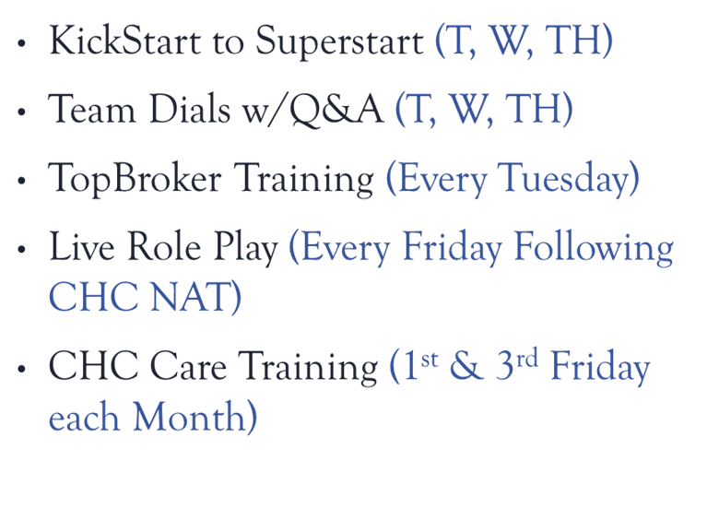
CHC Upcoming Trainings & Events
Upcoming Monday Madness Sessions
May 1st Fixed Benefit Plans
May 8th Pivot
CHC Trainings
May 4th Group Department Training
May 4th “Selling Against US Health & Freedom Life”
May 8th CHC Life Insurance Training
May 11th - JK Agent Sales Training Call

Slide 5




Slide 6

SPECIAL ENGAGEMENT
PHIL VOGT
“Selling Against US Health & Freedom Life”
Zoom Meeting Link: https://zoom.us/j/3738421209
Thursday, May 4th 5:00PM CST

Slide 7

Strategic Wealth Accumulation Tactics Event
Hilton Dallas/Plano Granite Park
5805 Granite Pkwy, Plano, TX 75024
Thursday, Friday, Saturday
June 1st-3rd 2023
BONUS: Joe Krivelow will reimburse agents $100 if they purchase a ticket to this event. Please submit your proof of purchase to Tanya Mosley, tmosley@chcquotes.com.
Would you like to attend but haven’t signed up?
If you have CHC Commissions, you will be able to use that to purchase you ticket. Email Tanya Mosley, tmosley@chcquotes.com to reserve your spot today!
DON'T MISS THIS OPPORTUNITY!

Slide 8

ACTIVITY
Dials
Leads
Networking
Gathering Sheets

Slide 9


CHC CARE: Healthcare Advocacy
Its not an insurance plan... But a service provided.
Services include:
- claims administration and submission
- shopping for lowest costing providers for specific services or procedures needed
- lowest cost on brand name Rx
- surprise medical bill negotiation
-Your Clients and Assistant will LOVE YOU!

Slide 10

Philadelphia American Contracting

Slide 11


COMPASS HEALTH CONSULTANTS
Video Training Link https://www.chcagents.com/traininglibrary/chc?wix-vod-video-id=47a9707d8c2f4468b85d028f60a7a944&wix-vod-comp-id=comp-kp95l168
Product and Sales Inquiries go to Kent Stansfield, agentsupport@chcquotes.com
Contracting Requests go to Tanya Mosley, tmosley@chcquotes.com. Agents are sent their Agent ID and the ENROLLMENT LINK. It does not quote.
The most recent brochures are located on the agency website, www.chcagents.com. All Compass Agents are welcome to join.

Slide 12

CHC Contest Updates
April 2023
CHC Care
April 1st- April 30th
Include CHC Care in your bundled quotes to earn some extra cash.
Sell 8-10 Applications $150
Sell 11-15 Applications $250
Sell 16+ Applications $500
Philadelphia American
April 1st – April 30th
Don’t let your clients miss this great product and earn some bonus money!
Sell your 1st Philadelphia American Application $200
Sell 3+ Applications earn $350
CHC Care Contest Totals
Agent | Total Applications
Jordan Krugman | 7
Kathryn Canlas | 5
Zac Masters | 7
*Majorie Bozer | 2
Philadelphia American Contest Totals
Agent | Total Applications
Tim McCormick | 3
Patrick Kniery | 2
Wendy Box | 1
Awesome Job Marjorie! Her start date was 4/7/2023!
Bonus payments will be made in June 2023. Compass Health Consultants has the right to adjust or modify the contest, as necessary.

Slide 13


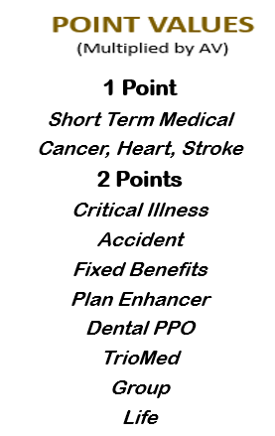

2023 2nd Quarter Allstate Bonus
Q2 Sales Goal 10 Million
$10,000 Total Bonus Payout
For every 10 paid applications, agents will receive an entry for one of 2 $1000 drawings.
If the 20% Goal is not attained:
Top 2 Agents will receive $500
&
Second Chance Drawing will take place.
*Bonus will be split by the top 12 agents based on weighted % of business that each agent produced.
**Drawing will be held if the $10 Million goal is met. Top 12 Agents are not eligible for the $2000 Second Chance Drawing. Bonus will be paid at the end of July 2023.

Slide 14

LEADERBOARD
Week-to-Date (Since 4/22/2023)
Rank Name Apps AV
1 Jamie Brink 15 $110,698.80
2 Phillip Vogt 5 $42,875.40
3 Janine Mistretta 5 $36,045.06
4 Jeremy Bright 4 $31,279.68
5 Clayton Casady 5 $27,159.00

Slide 15

Top Ten Agents
Top 10 Agents This Month
Rank Name #Apps
1 Jeffrey Seymour 58
2 Jennifer Earp 50
3 Tim McCormick 39
4 Jamie Baumeister 39
5 Trevor Magloire 37
6 Jordan Krugman 34
7 Stanley Trent Maness 31
8 Janet Rhonehouse 30
9 Anthony Carpenter 30
10 Phillip Vogt 30
Top 10 Agents Last Month
Rank Name #Apps
1 Brandon Halbert 48
2 Frederick Kirsch 47
3 Jennifer Earp 46
4 Tim McCormick 46
5 Jeremy Bright 43
6 Phillip Vogt 41
7 Zac MASTERS 41
8 Jeffrey Seymour 39
9 Richard Hyde 39
10 Jamie Baumeister 38

Slide 16


1st APPLICATION
Agent | Mentor
Marjorie Bozer | Kimberly Stevens
Heather Matesich | Bill Pauley
Catie Rice | Joe Krivelow
CONGRATULATIONS

Slide 17

COMPASS HEALTH CONSULTANTS
Do you have a satisfied customer review on
social media?
Do you have pictures of events and peers?
LET’S GROW TOGETHER!
Share with
@COMPASSHEALTHCONSULTANTS
Share your CHC photos with Sonali Balan, sbalan@chcquotes.com & Tanya Mosley, tmosley@chcquotes.com
GLASSDOOR REVIEWS
https://www.glassdoor.com/

