Slide 1
JK Agent Sales Training Call
Thursday, November 17st
1:00 PM CST

Slide 2
Upcoming Training & Events
60 Days left in Open Enrollment
JK OE Weekly Check-In,
Wednesdays 8:30 AM CST
TopBroker Weekly Training,
Tuesdays 1:00 PM CST
Life Product Training with Brian Dixon,
Friday, Dec 2nd, 12:00 PM CST
CHC Care Healthcare Advocacy Training,
Friday, Dec 2nd 10:00 AM CST
JK Agent Sales Training Call,
Thursday, December 15th, 1:00 PM CST
Make sure to subscribe to CHC Agency emails and join our chat group for additional trainings and events.
www.chcagents.com

Slide 3
COMPASS HEALTH CONSULTANTS UPDATES
IHP Support Email agentsupport@chcquotes.com
Disability – Updated training added to agency portal.
Must have 150 APPS for HST Partnership
Duration and renewals of 2022 short-term medical plans by state available.

Slide 4
TOPBROKER UPDATES
TopBroker Suspensions – TopBroker is monitored biweekly for inactivity and balances owed.
Keep TopBroker Active - Transfer Marketing Money, Add a CC.
CHC Exclusive Carriers have Lead Credits!!!!!
You will not receive lead or marketing credit of you do not submit business in TopBroker.
MKG Leads will increase to $19 per lead. EFFECTIVE December 1st.
A new bucket for ACA leads is being added. Each lead will be in real time at a cost of $4 per lead. Where do you want your ACA Leads?

Slide 5
IHP Group Plan Update
We have started the group.
There is still time to join.
CHC will contribute $100
Cards will arrive after Dec 1st.
Must be paid by the 15th month prior.
Peggy will handle payments monthly.

Slide 6
CHC Group Update
Communication – If there are issues, please notify CHC staff immediately.
CHC Group Division – groupquotes@chcquotes.com.
Bill Morrissey –wmorrissey@chcquotes.com
Jan Ash – jash@chcquotes.com
Respond to emails. If they are coming from ANYONE in the CHC staff, we are working and need an answer to ensure we are timely with your needs.
Respect timelines- If there is a deadline adhere to it. Act immediately to ensure you receive the expected need.

Slide 7
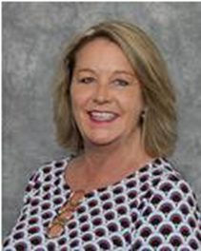
COMPASS HEALTH CONSULTANTS Open Enrollment Referral Program
ACA Referral Program
Send client info to acareferral@chcquotes.com
Agent will be paid $100 per submission.
Medicare Referral Program
Send client info to medicarereferral@chcquotes.com
Agents will be paid $100 per submission.
FL Blue Referral Program
Robin Deck Hutchison
Personal Lines Agent
941-376-8460 Work
941-724-8856 Fax
Robin.deck-hutchison@meadowbrook.com
Complete the required form to submit referrals.
Do NOT send your referrals to multiple email addresses.
If your referral does not meet the minimum income, please refer them to Medicaid.
Agents will be paid the referral fee when the policy is paid and in effect.

Slide 9
Agent Standings 2022
Top 10 Agents Last Month
Rank Name #Apps
1 Jeffrey Seymour 61
2 Lairah Seymour 55
3 Phillip Vogt 52
4 Faith Bratlie 52
5 Jennifer Earp 51
6 Janet Rhonehouse 48
7 Jamie Baumeister 44
8 Michael McAllister 38
9 Richard Hyde 38
10 Tim McCormick 38
Top 10 Agents This Month
Rank Name #Apps
1 Jeffrey Seymour 157
2 Jelisa Smith 148
3 Jennifer Earp 82
4 Paul Rosenthal 77
5 Phillip Vogt 72
6 Janine Mistretta 66
7 Jamie Baumeister 52
8 Faith Bratlie 50
9 Tim McCormick 46
10 John Hughes 44

Slide 10
CONGRATULATIONS
1ST APPLICATIONS
Agent | Manager
Connie Smith | Brian Dixon
Yvonne Valdez | Joe Krivelow
Patricia Calliste | Philip Vogt
Brittany Dieleman | Jeffrey Seymour
Charity Fox | Faith Bratlie
Juliana Desai-Parson | Ghaleb Zayed
Jesse Griffith | Philip Vogt

Slide 11
HAPPY ANNIVERSARY
Matthew Fisk 11/10
Patricia Zubal 11/14
Marvin Betts 11/20
Edward Meredith 11/28
Courtney Grogin-Dieckman 11/28

Slide 12
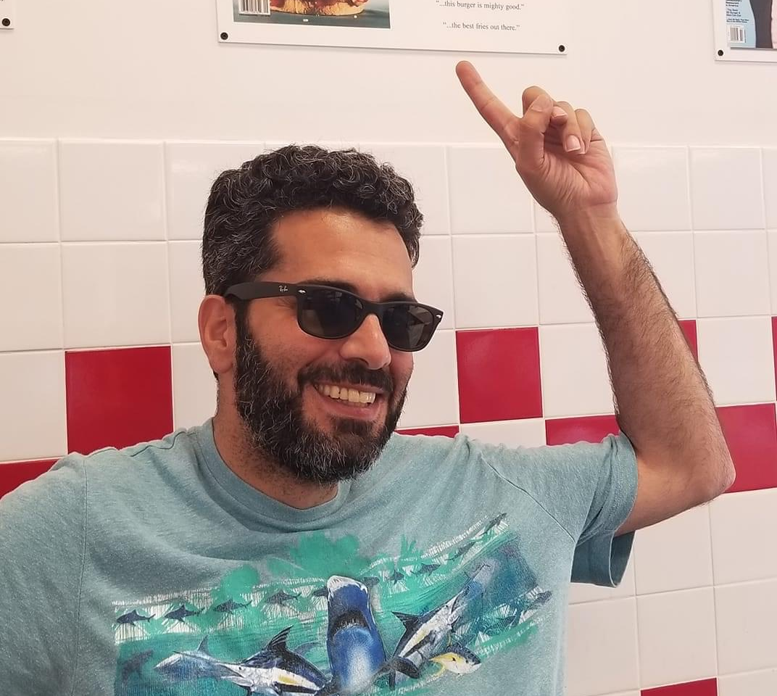
HAPPY ANNIVERSARY GHALEB ZAYED 15 YEARS

Slide 13
CONTEST UPDATE
Agent | Total Apps
Thomas Trifaro | 15
Zac Masters | 10
Philip Vogt | 10
Kent Stansfield | 5
Tim McCormick | 4
Heather Holben | 3
Jessica Skoney | 3
Paul Rosenthal | 3
Brian Drennon | 3
Anthony Carpenter | 2
Faith Bratlie | 2
Jeremy Bright | 2
Sherry Parker | 2
Yvonne Valdez | 2
November & December 2022
7 – 10 Applications $50 per app
20 - 25 Applications $100 per app
25+ Applications $150 per app
11 – 19 Applications $75 per app
16 Agents with 1 App Each!

Slide 14
HAPPY THANKSGIVING
Thank you for your hard work, day in and day out, to serve our clients and customers and make this company what it is. Thank you for your generosity, and your willingness to go above and beyond. Thank you for helping to make Compass Health Consultants what it is.
Have a wonderful Thanksgiving!

