Slide 1

COMPASS HEALTH CONSULTANTS
JK Agent Sales Training Call
Joe Krivelow, Founder
Thursday, January 12, 2023
1:00 PM Central
Zoom Meeting Link
https://zoom.us/j/3738421209

Slide 2

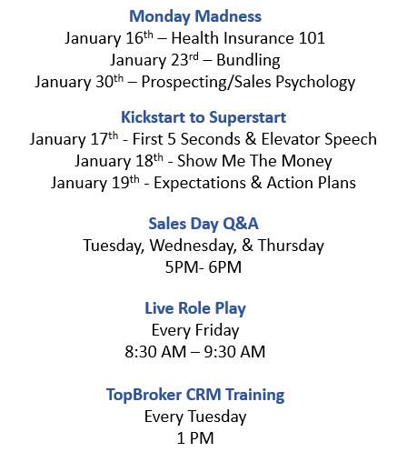


CHC Upcoming Events
Super Saturday Agent Training January 14th
CHC Care Healthcare Advocacy January 20th
CHC 2023 Agency Meeting February 24th
HST Banquet Awards February 25th & 26th
NOTE: Meetings are posted on TopBroker and the agency
portal, on the Training Calendar, www.chcagents.com.

Slide 3


2023 CHC Agency Meeting
Friday, February 24, 2023, 9:30 AM Eastern
2023 CHC Product Focus
How to run & manage a successful business
Awards
Q&A

Slide 4



Upcoming IHP Agent Trainings
IHP
Topic: IHP Training Webinar
Time: Jan 12,2023 04:00 PM Central Time (US and Canada)
Join Zoom Meeting
https://us06web.zoom.us/j/7648298246?pwd=NWlqZ0sybzRqRzdlNW1QR1hNSDdoUT09
Meeting ID: 764 829 8246
Topic: IHP Group Training
Time: Jan 18,2023 10:00 AM Central Time (US and Canada)
Join Zoom Meeting
https://us06web.zoom.us/j/7648298246?pwd=NWlqZ0sybzRqRzdlNW1QR1hNSDdoUT09
Meeting ID: 764 829 8246

Slide 5
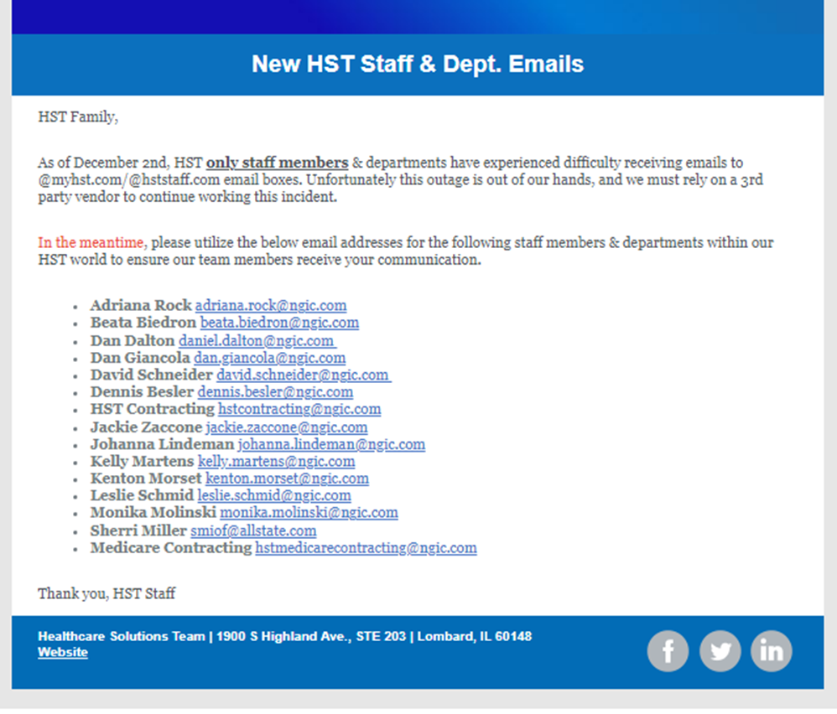
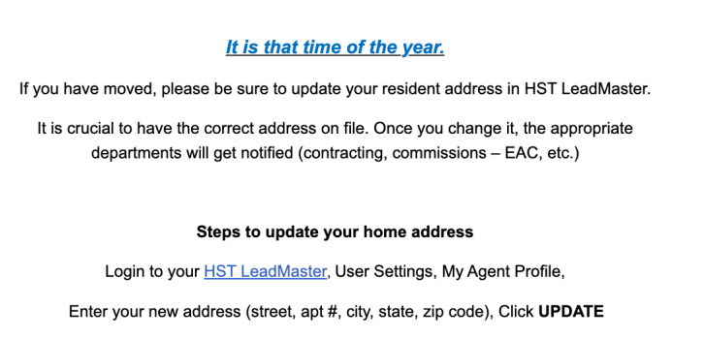
HST
Reminders 2023

Slide 6


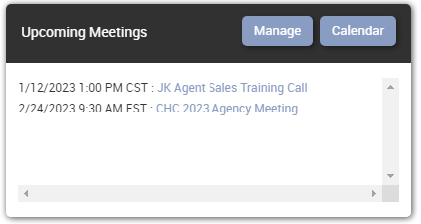
TopBroker CRM
2023 Update Link: https://www.youtube.com/watch?v=zhyZHoMgyQs&feature=youtu.be
Training every Tuesday, 1PM CST
Balances
Inactivity
Lead Credits

Slide 7

CHC Leads Update
MKG Leads (Premier Update)
Inbound Calls

Slide 8
CHC Care Healthcare Advocacy Update
Subject: New Contracting
Agents will need to complete a Marketing Agreement and return to Tanya. Once the information is submitted agents will receive a link to activate their personal link. The Marketing Agreement is located on www.chcagents.com.
Training Every 1st & 3rd Friday

Slide 9

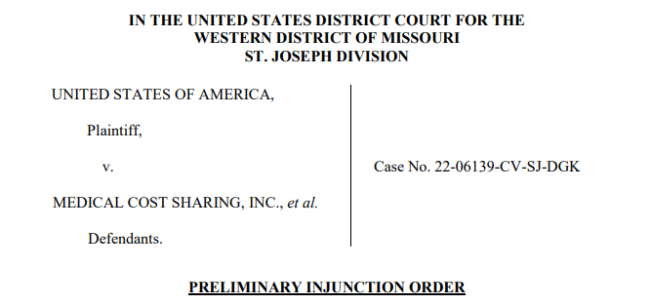

Slide 10


Agents currently have access to Humana group Dental Vision and life If they have 100 per month in Compass revenue. Starting Jan1st, we will have Access to IHP Group health. (As long as we have 5 participants) Compass will Contribute $100 per month.

Slide 11


IHP BackOffice Training
IHP BackOffice Highlights
Release Date: February 1st, 2023
Create new member enrollments from the back office, without having to go through the registration route
Make member and dependent demographic updates
View all members in one place, being able to access the member portal without having to maintain separate user credentials for each member.
Terminate members
Request refunds on behalf of members
Create and run reports (only their members' data)
Monitor and respond to member tickets (only their members)
Make payments for clients keep policy active if late.
Topic: IHP BackOffice Training
Time: Jan 26, 2023, 10:00 AM Central Time (US and Canada)
Join Zoom Meeting
https://us06web.zoom.us/j/7648298246?pwd=NWlqZ0sybzRqRzdlNW1QR1hNSDdoUT09
Meeting ID: 764 829 8246

Slide 12

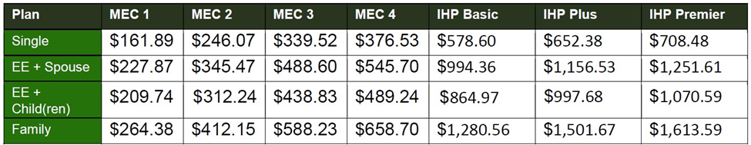
Dear Valued Customer,
We are writing this letter to inform you that the rates on the IHP Plans will be increasing for Limited Partners of Outreach Data Partners that are enrolled in the IHP Plans for 2023. The rates will be changing on your January deduction to cover your plan starting in February.
The increase will take place next month and the amount of the increase will vary depending on which plan that someone is enrolled in. The new rates that our clients will see will match the current rates we are offering the plan to our new customers. This is necessary for compliance, as this is a group plan, so all plan participants must be paying the same rate. The average increase is between 5% and 10%.

Slide 13

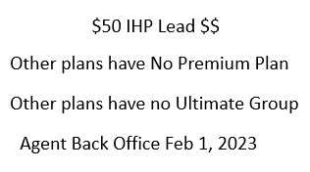
IHP Income Compare

Slide 14

IHP Group
Agent Payment Processing

Slide 15


CHC Carrier Discussion

Slide 16
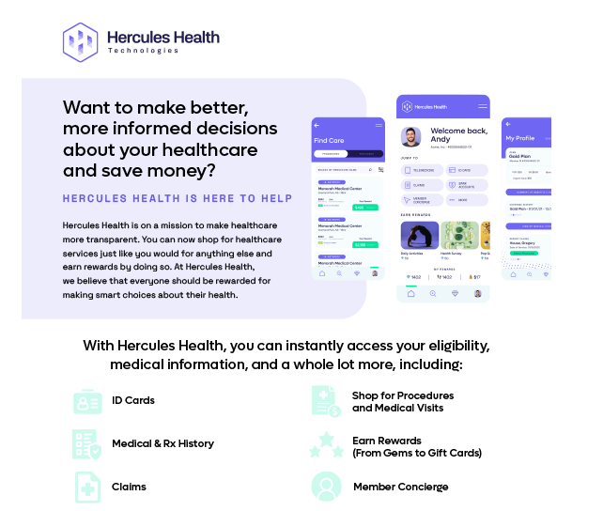
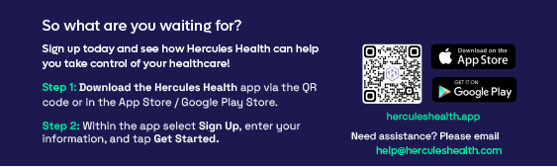
Subject: Elevate Wellness Informational: New Hercules Health App
The Local 713 and DH Cook have added a new app for its members for 2023! The new Hercules Health App will replace the Viveka App effective January 1, 2023. This new app comes with all new features and reward programs to earn cash.
https://msg-center-bucket.s3.us-east-2.amazonaws.com/files/5/1673284205_1673284195Hercules_Health.pdf

Slide 17


CHC Business Tool – VA Virtual Assistants
Dedicated VA's will work with you regularly as you delegate tasks during their 40-hour work week.
Having a VA will buy back your time to do what you do best, Help Others, CLOSE DEALS and make more Income.
5 Days
40-hour week
$800 – $1000 a month
$150 Upfront Deposit to secure your VA
Weekends Available
Call Leads
Screen Leads
Live Transfers
Schedule Appointments
Confirm Appointments
Marketing
For More Information contact Kate
1-(561) 835-5578
contact@beyondvirtualagentcenter.com
www.beyondvirtualagentcenter.com

Slide 18

CHC Recruiting Referral Contest
Step 1 Refer An Agent
Step 2 Referred Agent sells 1st App
Step 3 Referring Agent will receive $500 Lead Credits
Step 4 Get as many referrals as you can before March 1st

Slide 19



CONGRATULATIONS
Paul Drukker (RI)
Stephanie Regan (FL)
LaTisha Patton (OK)
Arthur Eastlake (VA)
Thomas Law II (FL)
Christopher Farmer (MD)
Alethea Loring (MA) 11 Years
Jackie Zaccone (IL) 13 Years
Adriana Rock (IL) 14 Years

Slide 20

CONGRATULATIONS
1ST Application
Agent | Manager
Brent Workinger | Briana Kramer
Thomas Killebrew | Tim McCormick
Keith Cheverie* | Joe Krivelow
Raymond Covino | Sean Burroughs
Deanna Denson-Jones | Kim Kirsch
Alissa Carpenter | Emmanuel Hotya
Lisa Zimmer | Stephanie Regan
Billy Royston | Emmanuel Hotya
Deric Edwards | Philip Vogt
Ashley Cagle | Faith Bratlie
Brett Richardson | Faith Bratlie
Izaiah Guerro | Allister Mcdonald
Michael McAllister | Michael D McAllister
Monica Workman | Brian Dixon
Stephen Grant | Ghaleb Zayed

Slide 21



Do you have a satisfied customer review on
social media? Share it with us!
@COMPASSHEALTHCONSULTANTS
Did you know, agents receive a bonus for
referring a recruit to HST/CHC?

Slide 22
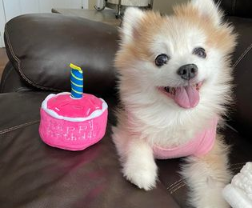
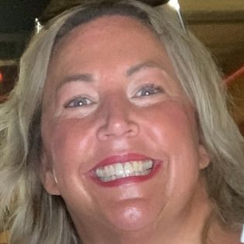

Happy Birthday
Liz

Slide 23

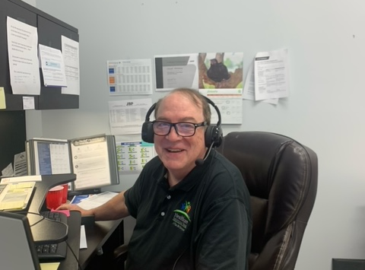
Happy Birthday, Don!

